Slide 1
Spooky Trades

Slide 2
Brain Teaser
You have 2 containers, a small one that holds 4 cups and a large one that holds 9 cups.
How can you use these to measure 6 cups of water?

Slide 3
Solution: Brain Teaser
Fill the glass with 9 cups of water. Empty it into the 4 cup glass twice so that you are left with 1 cup of water. Dump that into the 4 cup glass. Fill up the 9 cup glass again. Empty as much as you can (3 cups) into the smaller glass and you will be left with 6 cups

Slide 4
“Oil Futures Drunk Trading Incident of 2009”
Stephen Perkins was a Brent Crude broker for over a decade at PVM Oil
As a broker., he is supposed to execute for clients and not trade the firm’s money
June 29, 2009: After a long weekend of heavy drinking from a company-sponsored golf weekend, he continued drinking midday.
After this point, he had blacked out….

Slide 5
“Oil Futures Drunk Trading Incident of 2009”

Slide 6
“Oil Futures Drunk Trading Incident of 2009”
Perkins traded from 1:22 AM to 3:41 AM on June 30, 2009 while blacked
He traded 7 million barrels, or $520mm of oil
He was 69% of the volume of oil traded, and upwards of ten times average volume
Cost his firm 9.7mm, had income of only 12mm, resulting in a 7.6mm loss
Oil went from 71.40 to 73.50 per barrel, the highest in 8 months

Slide 7
World Bank Pandemic Emergency Financing Facility
(Pandemic Bonds)
Announced in 2016 and launched 2017 and was oversubscribed by 200%
Channels funding to pandemic responses in eligible countries based on spread and severity of pandemic
Orthomyxoviruses (influenza A), Coronaviruses (SARS, MERS, COVID) Filoviridae (Ebola, Marburg), and zoonotic diseases (Crimean Congo, Rift Valley, Lassa Fever)
Insurance Window – premiums funded by JPY, GER, of bonds and swaps
Cash window, GER provided additional funding for diseases that may not be eligible for funding under the insurance window

Slide 8
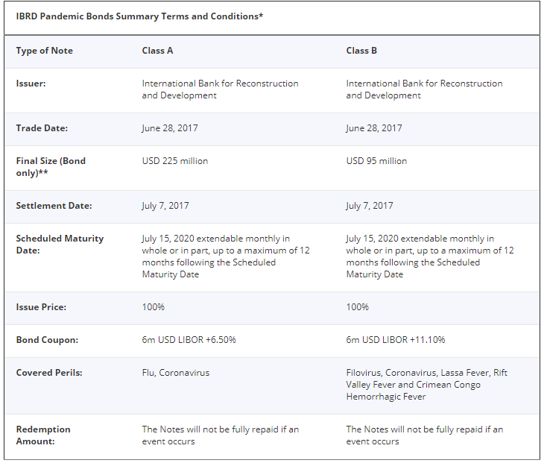
World Bank Pandemic Emergency Financing Facility
(Pandemic Bonds)

Slide 9
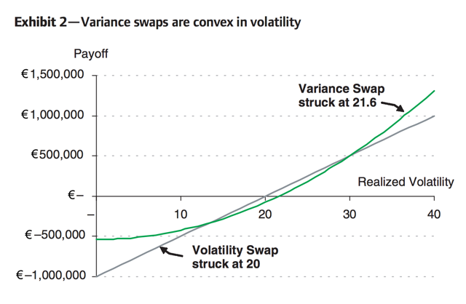
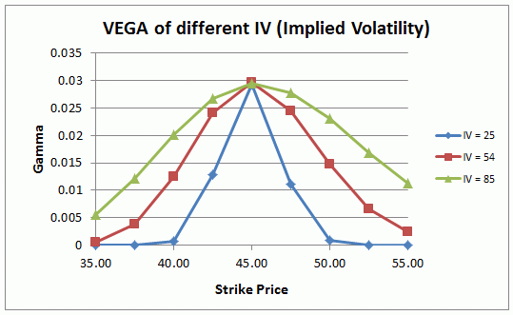
Variance and Volatility Swaps
Unlike options which reflect volatility ATM, vol and var swaps provide exposure to vol on the extremes

Slide 10
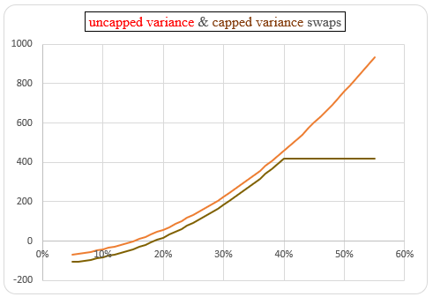
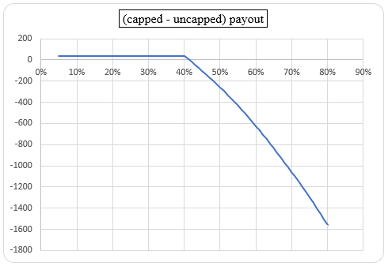
Capped-Uncapped Varswaps
Unlike options which reflect volatility ATM, vol and var swaps provide exposure to vol on the extremes

Slide 11
Malachite Capital
7 employees, 4 clients, and $600mm (levered to $1.5bb)
With 1.5bb AUM, large quantities of spreads are needed to realize income
Effectively offered insurance for extreme volatility events
Bank S&T more than willing to take on the exposure

Slide 12
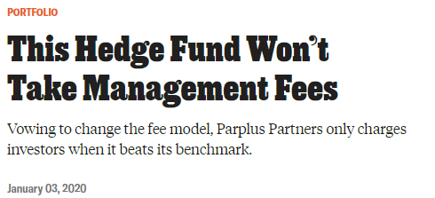
Parplus Partners
d

Slide 13
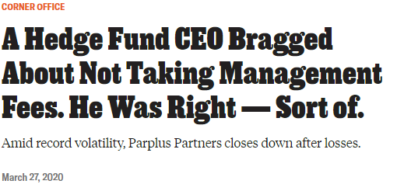
Parplus Partners
d

Slide 14
COVID Vol/Var Blowups
Ronin Capital – proprietary trading firm: CME auctioned off portfolio
AIMCo – public fund lost 3bb: “It’s the Tiffany Trump of Canadian pension funds”
Canada Pension Plan – USD or CAD 700mm losses
Plinth – $100mm fund, only lost 40%

Slide 15
Death Arbitrage
One version of life insurance: CDs with survivor options or death puts
Get principal back when you die- and can be owned jointly
Hedge funds would find people that were about to die and make them joint owners for a fixed fee
Banks would refuse to redeem bonds to hedge funds
“Fair exploit of a Wall Street Loophole”

Slide 16
Salad Oil Scandal
Anthony De Angelis
Con man at young age- worked at meat market and overcharged government under National School Lunch Act and delivered 2 million pounds of uninspected meat
Takes advantage of government programs through Salad Oil Scandal, stashed money in Swiss Bank Account
Jailed for 7 years only to become apart of Ponzi Schemes
Steps
Start Allied Crude Vegetable Oil Refining Co.
In 1955, to take advantage of US Government’s Food for Peace program (sell surplus commodities to Europe at low prices)
Corner Soybean Oil Market
Used his large inventories of commodities as collateral to get loans from banks and finance companies.
Bought soybean futures to drive up price of oil holdings, increasing value of inventory and allowed him to profit from future contracts
Lie
American Express gave De Angelis a loan and creates a division in field warehousing, which gives De Angelis receipts for millions of pounds of oil
Takes receipts and sells them discounted for cash and fakes receipts for oil he doesn’t have
Gets loans from 51 companies
Fills barrels with water and puts vegetable oil on top and used pipes connected to other tanks so oil could be transferred between tanks for inspectors
Collateralizes “inventory” to get loans. – Reported receipts and inventories were more than USDA inventories in the US (only had 6mm of reported 150mm in collateral)
Buys futures and corners the market
Futures prices rise in value, increasing his collateral value and futures P&L
Sells futures contracts at peak due to his own manipulation

Slide 17
Salad Oil Scandal Result
16 Wall Street firms bankrupted, all lenders recognized bad loans. Main brokers were bailed out for 450MM
Futures market crashed and soybean went from ~10/bushel to ~7.75 after scheme collapsed
Dow Jones loses 11Bn and NYSE halted trading
American Express loses 58MM and stock drops 50%.
Buffett steps in and buys 5% of company and makes 10x returns on investment

Slide 18
Howard Hubler
Bond trader at Morgan Stanley and MBS
Made about 20% of MS profits by selling MBS
Risks with this strategy
Loan exposure in between mortgage origination and selling off MBS
Solution: bought CDS on riskier BBB tranches
To fund this purchase: sold CDS on triple A rated MBS
Result: Basically insured the MBSs he was betting against- AAA securities begin to experience defaults and Hubler loses 9Bn because he sold more insurance on AAA MBS

Slide 19
Bre-X
CEO convinced by geologists (Guzman) to buy gold deposit in Busang, Indonesia
Announced significant amounts of gold→ stock price went soaring (from penny stock to CAD 286.50)
Guzman was salting samples and adding gold to them
Suharto grows interested and halts final approval of exploitation- saying Bre-X is too small. Creates JV with Freeport McMoRan
After deal is finalized, Guzman mysteriously found dead after falling out of helicopter to meet with Freeport executives
Freeport research indicates there’s basically no gold
CEO ended up selling 80MM worth of stock months before scam is revealed

Slide 20
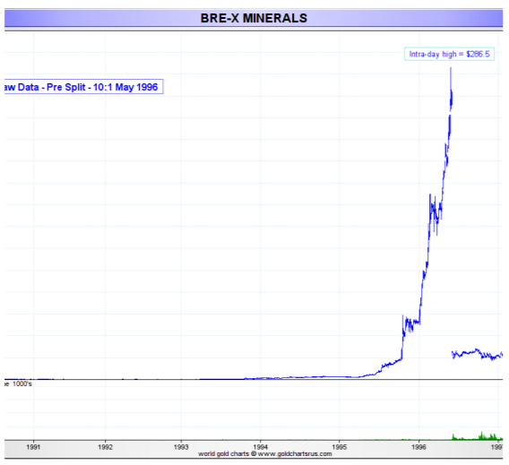
Bre-X

Slide 21
Ponzi Scheme
Uses investments of new investors to pay off older investors
Make people believe returns are coming from sales
Charles Ponzi did this in 1920 at first with postage stamp arbitrage (buying discounted postal reply coupons in other countries and redeemed them at face value in the US.
Collapse of the scheme: Financial journalist uncovers all of the lies (USPS said the stamps were not being sold in a huge quantity, profit per unit was very low, Ponzi didn’t invest in his own company

Slide 22
Bernie Madoff
One of largest and most famous Ponzi Schemes
Made steady returns of ~10% for decades
Came crashing down when SEC acted on tips from suspicious wealth managers, and clients wanting redemptions
Stole 20Bn from clients that he said was worth 65Bn

Slide 23
Get in Touch
Feel free to reach out to us over Facebook or email if you have any questions
www.quantfsnyu.com
quantfsnyu@gmail.com
President – Avni Patel (avni.patel@stern.nyu.edu)
Co – Head of All Portfolios – Cory Peshkin (cory.peshkin@stern.nyu.edu)
Co – Head of All Portfolios – Peter Park (peter.park@stern.nyu.edu)

