Slide 1
Intro to Sovereign Debt and Restructuring

Slide 2
Brain Teaser
There are 8 people sitting in a room at an investment bank. 4 of them are traders and 4 of them are bankers. They are split off into 4 teams of 2 for team-building exercises. What is the probability that each group of 2 has 1 trader and 1 banker?

Slide 3
Solution: Brain Teaser
Answer: 8/35
Select any person to be the first member of the group. 8/8 ways to do this. For their partner there are 4/7 valid people to select. Repeat for 2nd group, with 6/6 ways to select the first person and 3/5 ways to select the 2nd person. Same logic applies for 3rd group, for a total of 4/7 * 3/5 * 2/3 = 24/105 = 8/35. Note that we don’t have to worry about the 4th group because there will naturally be 1 banker and 1 trader left if the other groups are valid.

Slide 4
Why Do Governments Borrow?
Most, if not all, governments globally issue bonds:
Like companies, governments issue debt to satisfy their funding needs
A government can fund itself through either debt or taxes
Sovereign borrowing allows countries to run deficits
Investors buy sovereign bonds for capital generation
How do we measure sovereign borrowing?
Debt/GDP Ratio: Ratio of a country’s debt to its GDP
Deficit: The gap between a country’s revenue and its spending
Primary Balance: Essentially a deficit excluding interest expense
Government borrowing sources:
Bond markets: Typically the most common form of borrowing
Bilateral loans: Loans given by one country (e.g., China) to another for projects
Multilateral borrowing: Loans from international institutions (IMF, World Bank)

Slide 5
Foreign Currency Debt
FX debt refers to debt denominated in a foreign currency (“FX”)
FX borrowing takes place for several reasons:
Cheaper: Foreign investors offer cheaper interest rates than local currency bonds
FX Funding: By receiving dollars, countries can pay for imports
FX borrowing is often described as the “original sin” of EMs:
FX debt is dangerous because central banks surrender their ability to print money
When borrowing in FX, sovereigns must accumulate reserves denominated in FX
FX reserves can be used to pay debts, support currency pegs, or pay for imports
Most distress scenarios involve defaults on FX debts:
FX reserves are finite quantities and can run out if imbalances are too large
Export growth or prudent reserve management are needed to support FX debt
As such, investors often compare FX-denominated debts to exports

Slide 6
Bankrupt Governments?
“Happy families are all alike; every unhappy family is unhappy in its own way”
Common for different financial crises to be catalysts:
Banking crises: run on deposits, particularly FX deposits
Debt crisis: market loses confidence in payment of debt
Currency crisis: depreciation or spending reserves are not good for debt
Balance of payments crisis: running current account deficits that are too wide
In simple terms, bankruptcy means insufficient FX reserves:
FX reserves can be used to fund CA deficits/support currencies or debt
Absent a restructuring, this would require a massive adjustment
Market access is lost, meaning that governments can no longer roll over debts
Distinguishing between solvency and liquidity crises:
Solvency: Capacity to meet long-term financial obligations
Liquidity: Capacity to pay short-term obligations

Slide 7
Sovereign vs. Corporate Bankruptcy
Both aim to resolve the debt overhang problem
Being trapped with high debt expense limits government’s ability to spend
This can restrict how much is spent on things like education, health care, etc.
A restructuring can also allow a country to regain market access
However, there are a few key differences:
No global insolvency framework
Debtors face financial and political incentives
Different approach to fulcrum securities
Creditor composition varies considerably
IMF usually plays a key role in restructurings
There is no equivalent pro-debtor legal framework for sovereigns

Slide 8
CACs and Holdouts
Collective Action Clauses (“CACs”) are highly significant documents:
Stipulate the necessary thresholds of support for a restructuring to be approved
Often, restructurings encounter an issue known as the holdout problem
Holdout problem: Hedge funds buy bonds and “hold out”:
Holding out refers to when a hedge fund rejects an offer, awaiting better terms
CACs, by specifying thresholds of support, are supposed to deter this behavior
However, many sovereigns often have different legal terms on their bonds
Notable culprits include Elliott and Aurelius for their roles in Argentina

Slide 9
Restructuring Variables
Principal Haircuts are generally the most contentious:
Principal haircuts are typically driven by considerations tied to debt/GDP ratios
A debt/GDP ratio is a ratio of a country’s debt to the size of its economy
Not always a perfect metric, but is typically a good sign of distress
Coupon Cuts:
Coupon cuts can be considered if coupons are high, or liquidity is in focus
Step-up coupons are a common feature that also provide liquidity relief
Maturity Extensions
Maturity extensions are typically the most creditor friendly form of relief
However, they generally do not provide significant relief (“extend and pretend”)
Creditors are also more likely to accept these offers with credible governments

Slide 10
Role of the IMF
The International Monetary Fund is a global lender of last resort:
The IMF provides countries in financial distress with emergency funding
In return, the IMF usually requires countries to pursue economic reforms
Reforms can include running larger fiscal surpluses or passing specific laws
The IMF typically plays a key role in restructurings:
Many distressed sovereigns tend to be nations in an acute financial crisis
As such, they typically opt to receive funding from the IMF
Reaching a funding program with the IMF is generally positive for creditors
The IMF can also mandate a restructuring for aid:
IMF bylaws preclude the Fund from “lending into arrears” (LIA)
In other words, the IMF cannot lend to countries whose debt is unsustainable
To receive aid, a country must then pursue a restructuring
The IMF lends at lower interest rates than the market:
Despite this, reforms are often politically difficult, especially on spending
If certain conditions are not met, the IMF can delay funding
To incentivize compliance, the IMF lends in different tranches

Slide 11
Greece

Slide 12
Greece: Causes of Distress
Fiscal Imbalances were wide throughout the 2000s:
Greece had, for some time, run substantial fiscal deficits
A higher revised deficit in 2009 caused initial instability in credit markets
Entry into the Eurozone:
The establishment of the euro removed Greece’s monetary sovereignty
Euro area members do not pursue individual monetary policies
As such, there was no scope for using monetary stimulus nationally
Effects of the 2008 Financial Crisis:
Greece entered with limited fiscal space and no monetary policy
Greek unemployment rose to levels above the Great Depression
As a result, Greece had a de-facto, classic “FX debt” crisis:
Greece had no control of the currency debt was issued in (euros)
Greece had limited, if any, “reserves” that it could use to back debts

Slide 13
Crisis/RX Timeline
Oct-09: Greece revises its deficit higher from 7% to 12% of GDP
Greek credit spreads rise from 300 bps to >900 bps
Effectively, Greece loses market access and cannot roll over debts
May-10: Greece receives its first three-year bailout package
Moody’s downgrades Greece in mid-June
Credit spreads are back >800 bps by July
Oct 2010: Eurozone accepts possibility of a sovereign default
June 2011: First offer – creditors & EU propose a first offer
Propose four bond offerings with varying terms
However, proposal only covers bonds maturing in <9y
Oct 2011: Second offer – EU leaders offer steeper terms to creditors
One package offered to all bondholders
Feb 2012: Creditor committee accepts the EU offer

Slide 14
Key Features of Greece
Domestic Political Volatility:
Far-left SYRIZA won elections in 2015
Elections preceded in a major standoff with the IMF
Greece finally exited its last IMF program in 2018
Tensions between the EU and the IMF:
IMF continuously pushed for more debt reduction by the EU
EU stakeholders, particularly Germany, resisted these moves
Harsh Treatment of Creditors/Bondholders:
Only Iraq, Argentina, and Serbia achieved greater debt relief
Retrofitted Collective Action Clauses:
A very neat feature, but are unlikely to be replicated in the future
These were largely a function of the Greek domestic law system
Power of holdout creditors has greatly increased since this

Slide 15
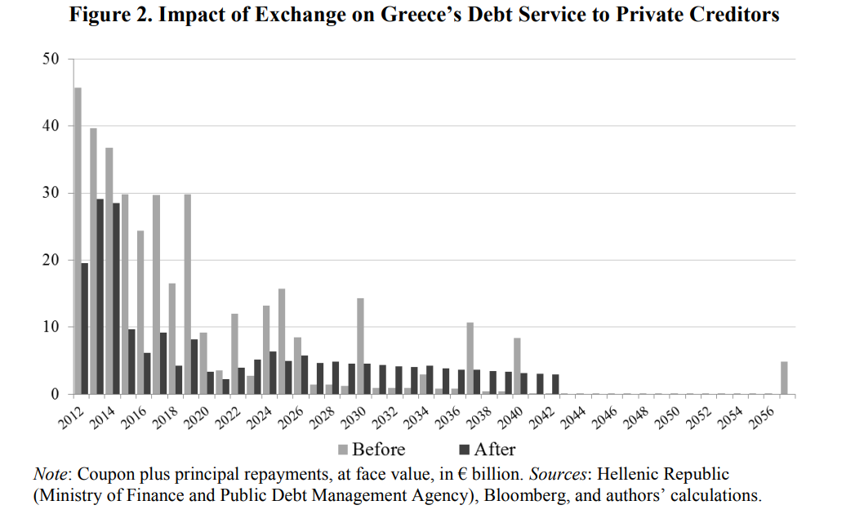
New Debt Schedule

Slide 16
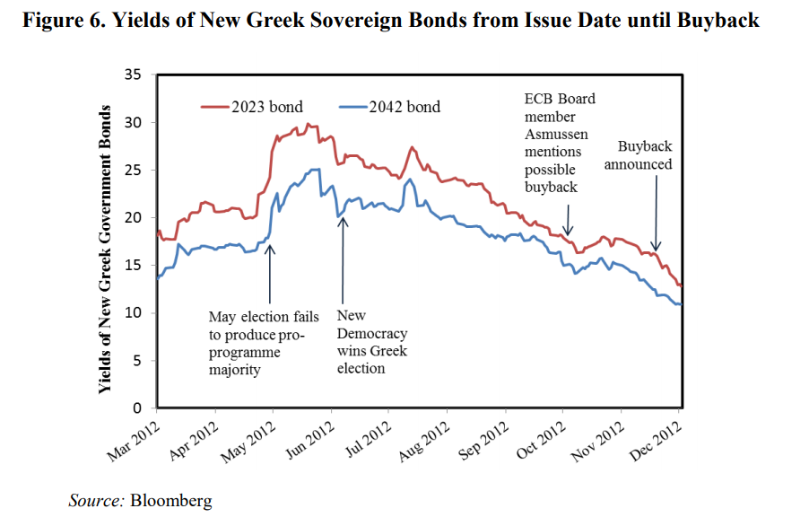
Trading Behavior

Slide 17
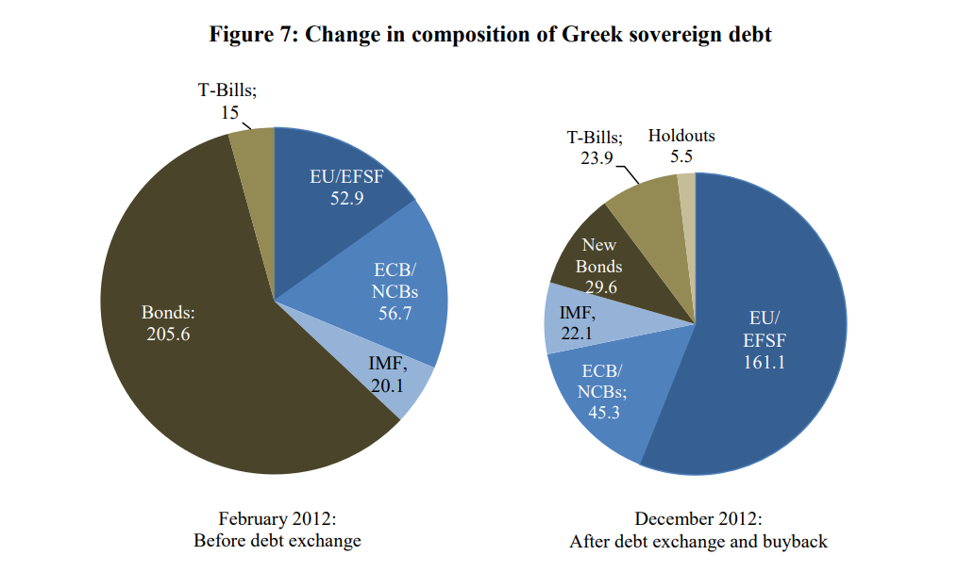
Shifting Capital Structure

Slide 18
Argentina

Slide 19
Sowing the Seeds of Crisis
Menem introduced a convertibility plan: 1 ARS = 1 USD
The peg was designed to contain inflation and force discipline
To be maintained, Argentina had to maintain FX reserves
Initially, this worked, but gave way to higher borrowing
Argentine debt rose and the peso became overvalued:
Convertibility reduced Argentine export competitiveness
Menem’s convertibility plan created a similar straitjacket:
High debt levels prevented the government from fiscal stimulus
The peg to the dollar prevented monetary policy
Cutting spending would only deepen the hit of the recession
Argentina defaulted in 2001 on its debt, owing:
$81.8b to private creditors
$9.3b to Paris Club creditors (i.e., Western governments)
$9.5b to the International Monetary Fund

Slide 20
Kirchner Era – 2005, 2010
Argentina issued a unilateral offer in 2005:
Of the $81.8b, $62.3b was exchanged into $35.2b
This represented a low recovery rate of 27-30% on an NPV basis
Argentina passed the Lock Law to ban revising these terms
The exchange had a very high non-participation rate (24%)
Economic recovery was unusually strong:
FX reserves grew from $10.2b in 2002 to $52.2b in 2010
Economy grew at an average rate of 8.5% from 2003-08
Argentina subsequently issued a new offer in 2010:
$12.4b of the eligible $18.4b of bonds were exchanged (67.7%)
After the offer, 91.3% of total defaulted debt was exchanged

Slide 21
Holdout Creditors - Elliott
Holdouts challenged Argentina under pari passu
Pari passu holds that equal creditors must be treated equally
Since the offer, Argentina remained current on exchanged debt
By not paying holdouts, they argued they were subordinated
Argentina defaulted again in 2014, but technically
Judge Griesa upheld the legal reasoning of the holdout creditors
Griesa went one step further in blocking such payments
Reformist candidate, Mauricio Macri, won 2015 elections
Macri agreed to finally return to negotiations with holdouts
Macri paid $4.65b, equivalent to 75% of the $5.9b left
This recovery rate was significantly higher than prior offers

Slide 22
The Fall of Macri
Argentina entered dire straits once again in 2018:
Macri lacked a majority in govt, sparing fiscal reforms
Macri issued $56b in external debt from 2016-18
Capital inflows led to overvalued peso, widening CA deficit
In 2018, IMF provided its largest ever program ($57b)
Central bank raised rates as high as 60% to defend the peso
Alberto Fernandez won an upset victory in 2019 elections
Fernandez had run with Cristina Fernandez de Kirchner as VP
Bond prices tumbled after this victory, anticipating a default
Fernandez sought to treat creditors friendlier than Kirchner
Fernandez emphasized Argentina’s position as a liquidity crisis
Explicitly referenced the terms of the Uruguay restructuring
Fernandez sought a deal with creditors on March 31, 2020

Slide 23
Fernandez’s Restructuring
Argentina’s 2020 restructuring achieved strong results:
Bondholders tendered 93.55% of eligible bonds
These cleared the necessary CAC threshold, enabling a deal
This only covered debt to private bondholders, not the IMF
Government’s next objective was to reach an IMF deal:
This objective has been complicated by necessary reforms
Fernandez has been reluctant to act ahead of midterms
Govt has provided significant fiscal support during COVID
Original deadline of May 2021 is almost certain to be broken
Midterm elections in Argentina are set for October 2021:
Fernandez, a politically weak, has largely given way to Cristina
His popularity has sunk because of COVID-19
This has made Fernandez more reliant on Cristina’s faction

Slide 24
Uruguay

Slide 25
Causes of Distress
Uruguay’s banking sector grew to be heavily dollarized
FX loans grew from 58% of lending in 1995 to 87% in 2002
Bank deposits also grew to be heavily dollarized (90% of deposits)
Argentine capital controls kicked off deposit outflows:
Argentine deposits often store their dollars in Uruguay
Argentine depositors suddenly withdrew their deposits
These flows eventually extended to resident depositors
Dollarization challenged the central bank’s role:
FX-denominated outflows strained the central bank’s FX reserves
The FX reserves at the time backed the peg of the Uruguayan peso
The peso ultimately had to be floated due to reduction in reserves
Devaluation led to a significant rise in debt/GDP:
Debt/GDP ratio jumped from 54% in 2001 to 94% in 2002
Govt faced large upcoming debt amortizations in 2003-07

Slide 26
Uruguay Terms
Bondholders were faced with two options:
Option I – Maturity Extension: same bonds with a 5-year extension
Option II – A Basket of Bonds
Basket included three external and four domestic bonds:
Maturities ranged from 7 years to 30 years
Step up coupons were tailored to appeal to floating rate bondholders
Uruguay had made aggressive use of exit consents
Exit consents are a tool to help boost participation in restructurings
Uruguay proposed stripping bondholders of specific legal rights
Removals included sovereign immunity, listing requirement, & cross defaults
These bonds did not have any form of a principal haircut
The outcome was very friendly to creditors
The offers received a 93% participation rate from creditors

Slide 27
Get in Touch
Feel free to reach out to us over Facebook or email if you have any questions
www.quantfsnyu.com
quantfsnyu@gmail.com
President – Ram Ramanathan (rer407@stern.nyu.edu)
Vice-President – Alex Poon (alex.poon@stern.nyu.edu)
Co – Head of All Portfolios – Connor Sheehy (connor.sheehy@stern.nyu.edu)
Co – Head of All Portfolios – Kevin Duan (skd359@stern.nyu.edu)

