Slide 1
Intro to Derivatives: Options

Slide 2
Brainteaser!
There are 8 people sitting in a room at an investment bank. 4 of them are traders and 4 of them are bankers. They are split off into 4 teams of 2 for team-building exercises. What is the probability that each group of 2 has 1 trader and 1 banker?

Slide 3
Answer: Probability Approach
Select any person to be the first member of the group. 8/8 ways to do this. For their partner there are 4/7 valid people to select. Repeat for 2nd group, with 6/6 ways to select the first person and 3/5 ways to select the 2nd person. Same logic applies for 3rd group, for a total of 4/7 * 3/5 * 2/3 = 24/105 = 8/35. Note that we don’t have to worry about the 4th group because there will naturally be 1 banker and 1 trader left if the other groups are valid.

Slide 4
Answer: Combinations Approach
The total number of combinations is 8 choose 2 * 6 choose 2 * 4 choose 2 divided by 4! because the selection of groups does not require order. This comes out to 105 combinations. The number of valid groups can be thought of as 4*4 for group 1, 3*3 for group 2, 2*2 for group 3. Again divided by 4! because the order does not matter. This comes out to 24 valid combinations, for a total probability of 24/105 = 8/35

Slide 5
What Is a Derivative?
Derivative
A derivative is a financial instrument, whose value is from the value of another underlying asset
When the price of the underlying changes, the value of the derivative also changes
Types of Derivatives
Forwards/Futures
Options
Swaps
Warrants/Convertibles

Slide 6
What was the first financial derivative?
British – Opium Derivatives, 1850
Dutch – Tulip Derivatives, 1636
Japan – Dojima Rice Exchange, 1697
India – Cotton Derivatives, 1875
Chicago – Chicago Board of Trade Grain Futures, 1864

Slide 7
Futures and Forwards
Futures and Forwards
Allow you to lock in a price at some point in the future.
Physical or cash settled
Often used by corporations for hedging
Main asset classes: Equity indices, VIX, commodities, FX, rates
Pricing
$$Futures Price≈E\left[Spot @ T\right]≈Forward Price$$
Negotiate price to pay at t=T
Exchange underlying at agreed prior price*
t=0
t=t
t=T

Slide 8
Pricing Futures
$$Futures Price≈disc.(E_{t}\left[{Spot}_{T}\right])≈Forward Price$$
1. Arbitrage Pricing
$Futures Price \left(t,T\right)=Spot\left(t\right)∗e^{(r+u−y)(T−t)}$
2. Expectation Pricing
$$Futures Price=E_{t}\left\{Spot\left(T\right)\right\}∗e^{(r)(T−t)}$$

Slide 9
Futures and Forwards Compared
Futures | Forwards
Exchange Traded | Over the Counter
Standardized | Bespoke
No counterparty risk | Credit default risk of counterparty
Actively Traded | Non-transferrable
Marked to Market | Open and Close
Margined | Unmargined

Slide 10
Counterparty Risk
Counterparty Risk
The risk that one of the parties within a transaction may default or renege on a prior obligation
Is this generally a problem?
No
Buyer
Forward
Seller
Buyer
Future
Clearinghouse
Seller

Slide 11
What Is an Option?
Option
An option is a contract which gives the buyer (the owner/holder of the option) the right, not the obligation, to buy or sell an underlying asset or instrument at a specified strike price on a specified date
Breaking it Down
Right- I don’t have to buy/sell the option if I don’t want to (option wouldn’t be exercised)
Underlying asset- what is the option on (ie AAPL stock)
Strike price- parties agree on a set price ie, I want to buy the right to buy APPL stock at 120 dollars for the next 100 days

Slide 12
Key Definitions
Call Option
An agreement that gives the buyer the right, but not the obligation, to buy an underlying asset at a specified price within a specific time period
Put Option
An agreement that gives the buyer the right, but not the obligation, to sell an underlying asset at a specified price within a specific time period
American vs European
European = No early exercise
Buying a call
Buying a put
Selling a call or put (takes oblig.)

Slide 13
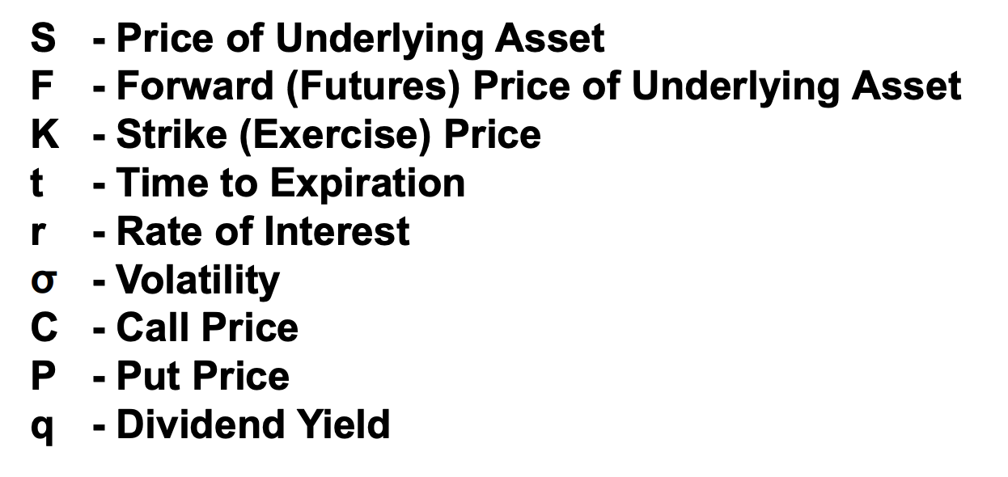
Other Key Terms To Know
Which of these are known versus unknown?

Slide 14
Concept of Moneyness
Options are heavily dependent on the concept of moneyness – relative position of the price of the underlying asset with respect to the strike price of the option
In the Money
At the Money
Out of the Money

Slide 15
2 Types of Options
American Options – buyer can exercise option early
European Options – buyer cannot exercise option early and has to wait until expiration
When would you exercise your option early?

Slide 16
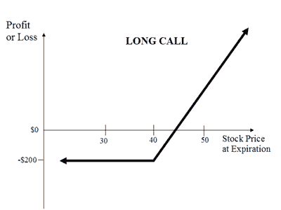
Payoff Diagram For Buying A Call

Slide 17
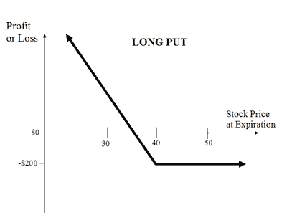
Payoff Diagram For Buying A Put

Slide 18
Example
Is buying a 130 strike put the same as selling a 130 strike call?

Slide 19
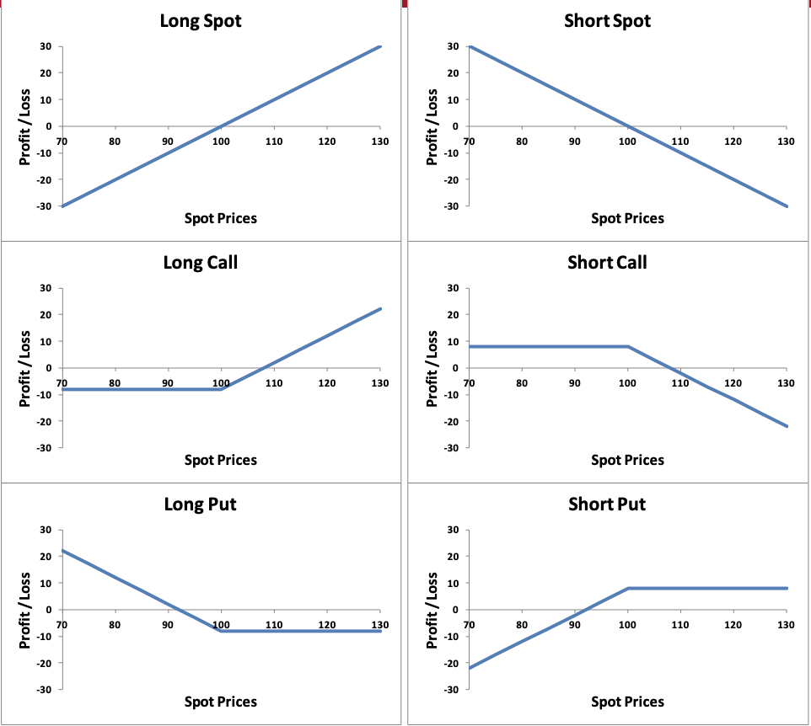
Summary Of Payoff Diagrams

Slide 20
Why People Trade Options
Leverage
Hedging – Protected downside risk
Speculation
Volatility
Have a unique view that you can’t play with just the underlying asset

Slide 21
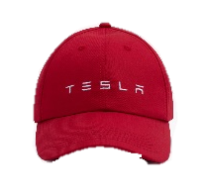
Example - What Should cory do?
Cory is a die-hard Tesla fan and put his entire life savings into TSLA stock.
Now he’s slightly worried that the stock price is going to go down and he’s going to lose it all
How can he protect himself?
Buy Call
Buy Put
Sell Call
Sell Put

Slide 22
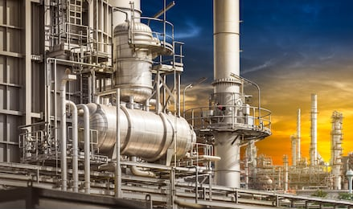
Example - What Should Peter do?
Peter is an oil refiner (buys crude oil, refines it, and sells it as heating oil) and wants to hedge his oil exposure through options.
What should Peter do?
Buy Call
Buy Put
Sell Call
Sell Put

Slide 23
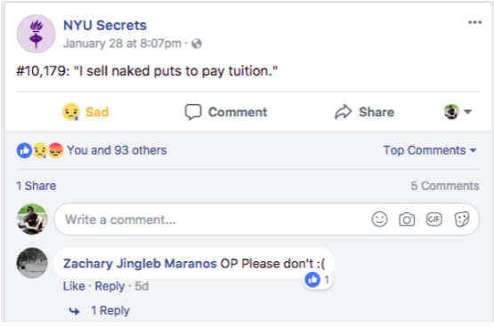
Example of what not to do

Slide 24
Different Strategies: Volatility Strategies
What would it look like if you bought a call and a put both ATM?

Slide 25
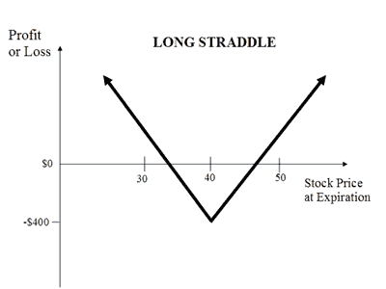
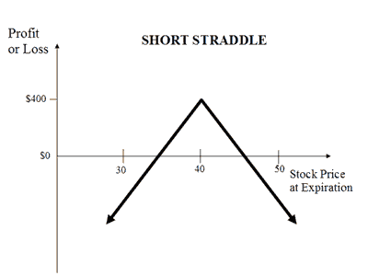
Different Strategies: Volatility Strategies
Buying ATM Call and ATM Put
Make money if underlying moves in either direction
Long volatility

Slide 26
Different Strategies: Hedging
What would it look like if you buy an ITM call and sell an OTM call?

Slide 27
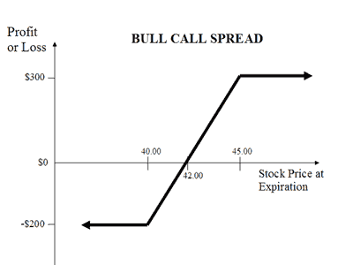
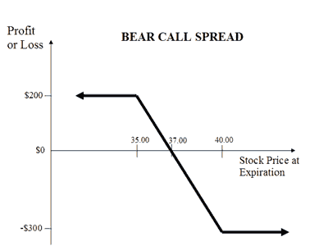
Different Strategies: Hedging
Bull Call Spread is buying lower strike call and selling higher strike call
Limited downside but limited upside
Bullish on underlying but think there won’t be much movement up
Not really view on volatility but benefit as volatility decreases as you are more correct
How would you make bull and bear put spreads?

Slide 28
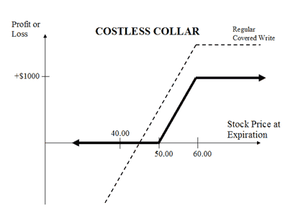
Real World Example: Cost-less Collar
Costless Collar
Long 100 Shares
Short 1 OTM Call
Long 1 ATM Put
Frequently used in commodities
Cost of the OTM Call = ATM Put such that the trade is free (remember they are intrinsically long the underlying)
Often done on a 2-6 quarter basis

Slide 29
Next week Options pricing / Black scholes option greeks Skew Put Call Parity

