Slide 1
Intro to Credit and Bankruptcy

Slide 2
Brain Teaser
How many trailing zeros are in 100 factorial
100! = 100 * 99 * 98 * … * 2 * 1

Slide 3
Solution: Brain Teaser
Answer: 24
A trailing zero is created when a multiple of 5 is multiplied by a multiple of 2 (15 * 8 = 120)
There are 20 5’s between 5 and 100
25, 50, 75, and 100 contain 2 5’s, so we have 4 additional ones
There are more 2’s than 5’s, so the answer is the number of 5’s which is 20 + 4 = 24

Slide 4
What is Enterprise Value?
Enterprise Value = Equity Value + Debt – Cash
Value of Operating Assets of the Business
Cost to Acquire Business
Must pay down debt and equity holders to fully acquire a company
Halal Cart Operating Assets
_
Halal Cart Financial Assets
_

Slide 5
What is Enterprise Value?
Enterprise Value = Equity Value + Debt – Cash
Value of Operating Assets of the Business
Cost to Acquire Business
Must pay down debt and equity holders to fully acquire a company
Halal Cart Operating Assets
Cart itself
Food/Inventory
Halal Cart Financial Assets
Cash

Slide 6
What is Enterprise Value?
Why do we subtract Cash?
Cash is not an operating asset, it is a financial asset
In theory cash can be used to pay down debt, strategic decision for company to hold onto cash
If you were to acquire a business, you would pay out equity holders, debt holders, but get to keep the cash so the true cost is net of cash

Slide 7
What is Capital Structure?
How a firm funds its operations/growth
Can be either debt or equity
Cash/Financial Assets ($100)
Cash/Financial Assets ($100)
Market Capitalization (Equity Value)
($400)
Operating Assets
($500)
Equity (Net of Cash)
($300)
Enterprise Value
($500)
Debt
($200)

Slide 8
Modigliani-Miller Theorem
In a perfect world, the value of a firm is independent of capital structure
Value of a firm – Enterprise Value
Perfect World
No taxes
No transactions costs
No bankruptcy costs or financial distress costs
No information asymmetry
Securities are fairly priced

Slide 9
Modigliani-Miller Theorem
A firm worth $1000 is worth $1000 regardless of how it is financed
80% debt
$800 in debt
$200 in equity
20% debt
$200 in debt
$800 in equity
Why?
In theory why should it matter how you finance?
Cost of Capital
In a perfect world, financing with debt is cheaper, but results in higher Cost of Equity, therefore Cost of Capital doesn’t change

Slide 10
Debt vs Equity
Why Debt?
_
Why Equity?
_

Slide 11
Debt vs Equity
Why Debt?
Save on taxes through interest tax shield
No dilution of ownership
Upside for debtors capped at face value
Why Equity?
No interest expenses
No covenants
Beneficial if stock is overvalued (less dilution, cheaper cost of capital)

Slide 12
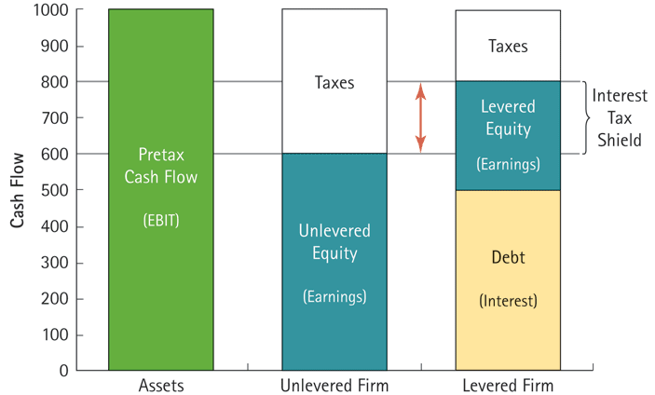
Tax-Shield
Tax shield on interest creates value
Debt gets paid pre-tax, the more debt, the less the tax you pay, higher EV

Slide 13
Capped Upside
Company X
Currently worth $1,000
Financed 50% debt, 50% Equity
If Firm Value doubles

Slide 14
Capped Upside
Company X
Currently worth $1,000
Financed 50% debt, 50% Equity
If Firm Value doubles
Now worth $2,000
Debt still worth $500 – Capped upside
Whereas Equity has grown to $1,500
Equity can grow, whereas debt is fixed

Slide 15
Debt

Slide 16
Secured vs. Unsecured Debt
Debt with a collateral interest is called secured
Secured | Unsecured
Backed by collateral Based on quality of collateral and creditworthiness Often floating rate (libor+spread) Mandatory Amortization Lower interest rate Often banks are lenders | No collateral Based only on creditworthiness of borrower Often fixed rate Can be bullet payment or paid in kind Higher interest rate

Slide 17
Covenants
What are covenants?

Slide 18
Covenants
What are covenants?
Promises agreed to by the borrower
If they do not abide, lender can place borrower in default
Meant to protect lender
In theory, the more covenants, the lower the interest rate because the lender has less risk
Maintenance vs. Incurrence

Slide 19
Maintenance Covenants
Tested regularly and borrower must be in compliance
Examples:
Debt/EBITDA ratio below certain number
Interest Coverage ratio higher than certain number
If they are not in compliance can be placed in technical default

Slide 20
Incurrence Covenants
Only comes into effect if the borrower is trying to do a specific action
If the borrower wants to take on new debt, debt/ebitda must be below 5.0x after taking on the new debt
This does not mean they cannot have a debt/ebitda ratio of 6.0x, just must be below 5.0x after taking on new debt

Slide 21
Covenant Breach/Distress
Borrower is placed in technical default
Depending on credit docs, lender can accelerate if there is a provision allowing this
In general, lenders will look to work with borrower to cure technical default as acceleration is rarely the best method
All about preserving their return
Rating Downgrade
Equity trades close to 0, debt trading at discount
Poor Financials (Cash Flow, AP, Margins, Revenue etc.)

Slide 22
Why Companies go into Distress
Unrealistic Business Plan – LBO
Economic Downturn – COVID
Mismanagement - Overspending etc
Secular Change in Industry – Amazon with Brick and Mortar
Above results in inability to meet obligations

Slide 23
Signs of Distress
Stretching Accounts Payable
Deferring Capex
Declining EBITDA/Margins leading to large Debt/EBITDA
Deteriorating Margins
Debt trading at a discount
Equity Value trading at Option Value

Slide 24
Option Value
Why Equity of a bankrupt/distress company rarely trades at 0
Can be applied to debt as well where a clearly out of the money unsecured bond could be trading above 0
The equity (or unsecured bond) is effectively an option on the value of the firm increasing, and the strike price is the price you pay for the equity

Slide 25
Cost of Distress/Debt Overhang
Higher interest rates on future debt
Forced selling of assets
Indirect Costs – Reducing CapEx on valuable projects
Conflicts of Interest
Creditors/Lenders want company to preserve value since they are higher in the capital structure
Equity Holders want company to take on risky projects, so their “option” pays out
Debt Overhang
Existing debt will prevent financing for Positive NPV projects because value accrues to senior debt holders

Slide 26
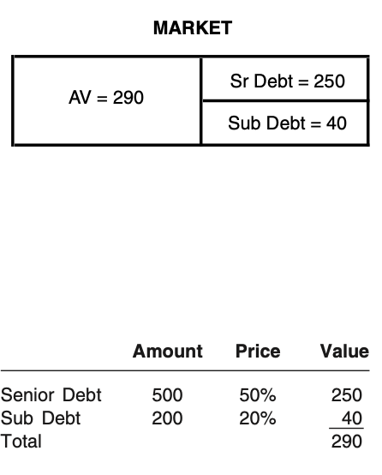
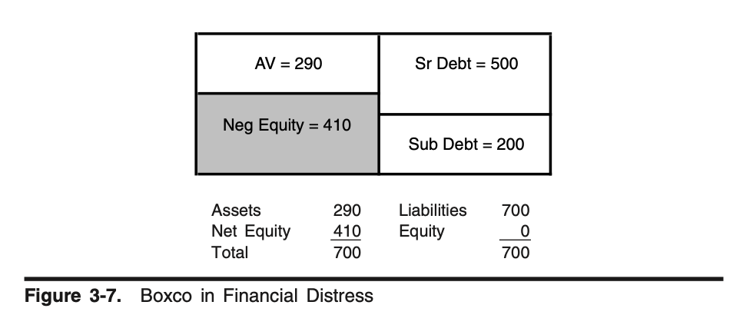
Debt Overhang Example
No equity or sub-debt holder would fund a positive NPV project here because current value is 290, and future value creation up to 210 flows directly to senior debt holders

Slide 27
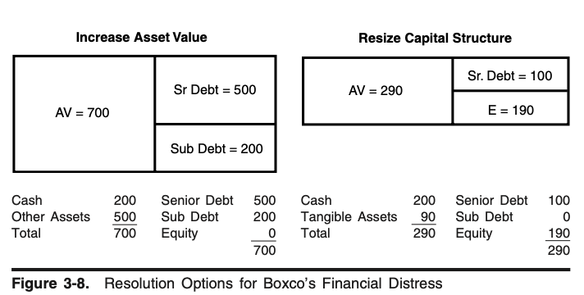
Solving Distress
Increase Asset Value – Strategic and Operational Changes
Resize Capital Structure – OOC Restructuring, Bankruptcy

Slide 28
Creditors POV

Slide 29
Bankruptcy – Chapter 11 and 7
Legal process to help debtor/borrower when they are in distress and cannot cover their liabilities
Provides debtor with some protections
Out of Court Restructuring is another option, as it is cheaper and has no indirect costs, but the debtor does not get Chapter 11 protections
Debtor creates a plan for their future
This plan will include a firm valuation and how each creditor is treated
Senior creditors prefer low firm valuation
Junior creditors prefer higher firm valuation
Chapter 7 – Liquidation, when the firm cannot operate as a going concern in the future

Slide 30
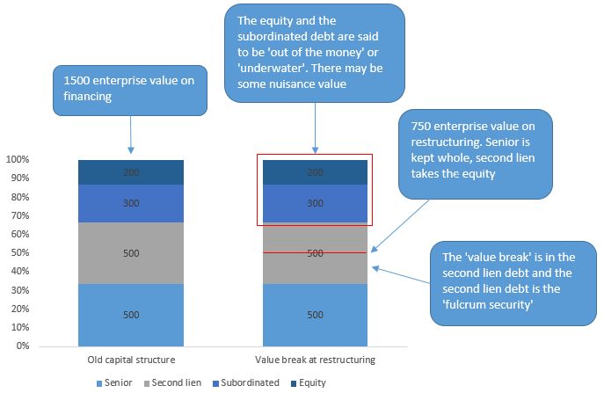
Waterfall and Fulcrum Security

Slide 31
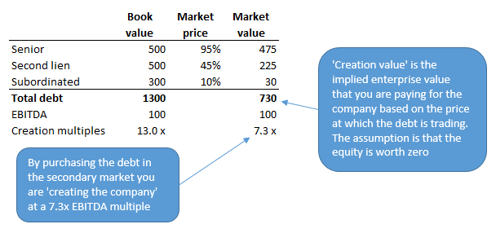
Creation Value

Slide 32
Lender Considerations
Because upside is capped in credit at yield/coupon (unless buying at significant discount with NT maturity), downside protection is everything
Factors of Risk
Priority
Time
Leverage
Considerations
Ability to pay interest - FCF Generation
Ability to refinance/repay at maturity – Terminal Value of business
Collateral Coverage if secured

Slide 33
Managing Priority
Negative Pledge Covenants
Prevents a lender/creditor from being “primed”
Being ”primed” is when a borrower takes on debt from another lender that is of higher priority to you either contractually or through a security interest (collateral)
Restricted Payments
Prevents dividend payments for example which are payments to a holder lower in the capital structure (equity)

Slide 34
Managing Leverage
Debt/EBITDA and Interest Coverage Covenants
Prevents borrower from being in too risky of a position
Gives lender an “out” if they are in violation depending on the terms of the credit documents

Slide 35
Investing in Debt
When investing in debt need to factor all of this in
Your perceived risk drives the interest rate/coupon on the debt
In the current environment almost, any company has been able to raise debt because of the low interest rates (until recently)
However, the majority of the time, there is a certain point where a company is deemed too risky to be given financing no matter the interest rate
Interest rate may take up all of their FCF generation at a certain point meaning they can’t operate profitably

Slide 36
Get in Touch
Feel free to reach out to us over Facebook or email if you have any questions
www.quantfsnyu.com
quantfsnyu@gmail.com
President – Ram Ramanathan (rer407@stern.nyu.edu)
Vice-President – Alex Poon (alex.poon@stern.nyu.edu)
Co – Head of All Portfolios – Connor Sheehy (connor.sheehy@stern.nyu.edu)
Co – Head of All Portfolios – Kevin Duan (skd359@stern.nyu.edu)

