Slide 1
Intro to Bonds

Slide 2
Brain Teaser
There is a lightbulb inside a closet. The door is closed and you cannot see if the light is on or off through the door. However, you know the light is off to start.
Outside the closet, there are 3 light switches.
One of the door light switches controls the lightbulb in the closet. You can flip the switches however you want, but once you open the door, you can no longer touch the switches.
How do you figure out without a doubt which of the three light switches controls the light?
Learning
Investing
Community

Slide 3
Solution: Brain Teaser
Flip switch 1 for a few minutes.
Then turn it off. Flip switch 2.
Open the closet door.
If the light is on, its switch 2. If the bulb is a little warm, its switch 1. And if it’s cold, its switch 3.
Learning
Investing
Community

Slide 4
What is a bond?
“Fixed Income”
Price of a bond
Interest
Principal
Zero Coupon vs. Coupon

Slide 5
Bond Terminology
Face Value
Principal
Coupon
Yield
Premium
Discount
Par

Slide 6
Time Value of Money
“A dollar today is worth more than a dollar tomorrow”
Why?

Slide 7
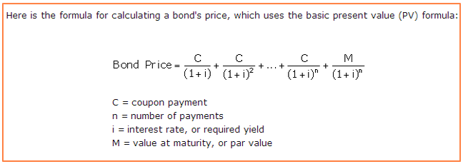
Bond Pricing

Slide 8
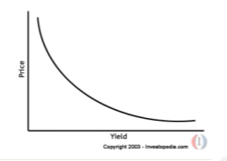
Bond Prices and Yields
Inverse relationship between bond price and bond yield

Slide 9
How to Value a Zero Coupon Bond vs Coupon Bond
1 year ZCB pays out principal of 100. Assuming a discount rate of 5%, what should that bond be worth today?
2 year coupon bond pays interest annually of 4% of 100 principal. Assuming discount rate of 5% what should bond be worth today?
Around $98
Learning
Investing
Community

Slide 10
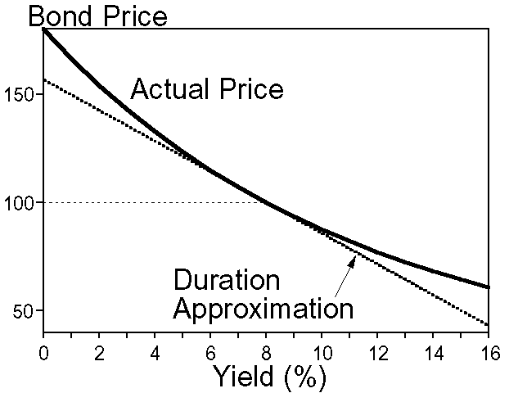
Duration
1st derivative of a yield curve
Intuition: Change in price of a bond for a 1% change in the interest rate

Slide 11
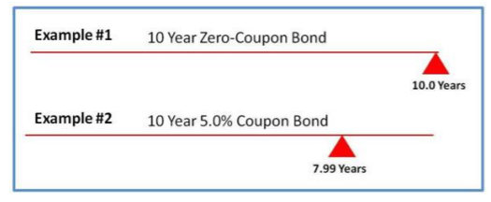
Duration Intuition
Can be considered approximation of average payback period of bond

Slide 12
Duration
Is duration higher for a 5 year ZCB or a 10 year ZCB?
Is duration higher for a 1 year bond that pays 5% interest or 10% interest?

Slide 13
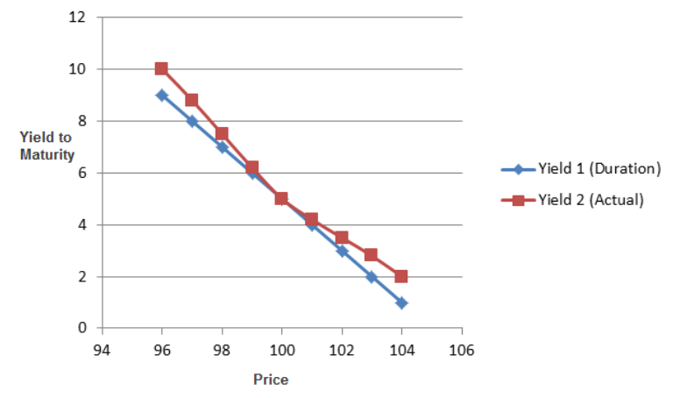
Benefits of Duration / Issues with Duration
For hedging
Limits exposure to changing rates
But, not perfect (other methods for estimating this sensitivity)

Slide 14
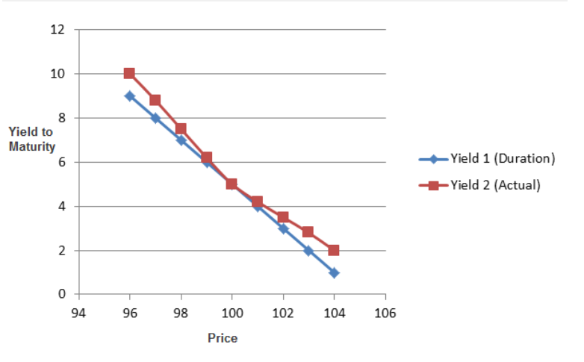
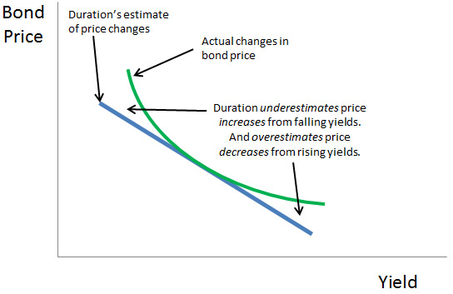
Convexity
Convexity measures change in duration as interest rates change
Differential between linear duration measure and actual price change

Slide 15
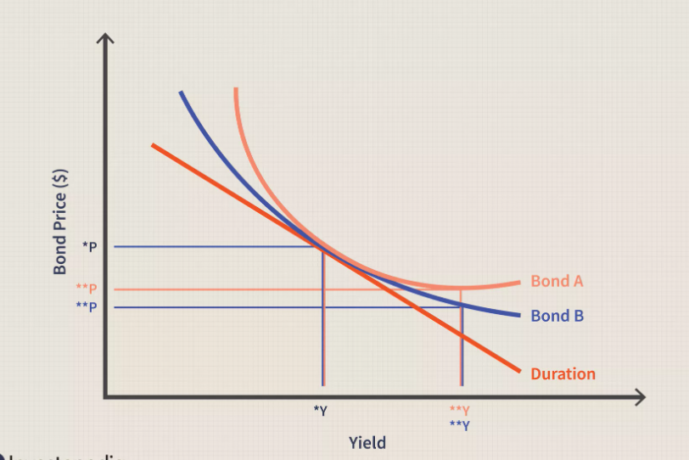
Convexity

Slide 16
What Effects Interest Rates?
Fischer Equation: Nominal rates = real + inflation expectations
Central Bank
Credit/Default Risk
Term premium (risk premium)
Demand for asset

Slide 17
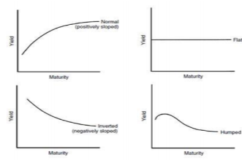
Yield Curve
Plots yields of bonds across different maturities
When can it be upward sloping? Downward sloping? Flat?

Slide 18
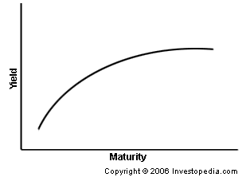
Trading Bonds: Steepener
Long short end of the yield curve – yields go down
Short long end of the yield curve - yields go up
Cost of the trade
What would a flattener be?

Slide 19
Steepener Trade
When would we use this?
Duration hedging during bond trades
Difficulties of trade – curves rarely steepen

Slide 20
TIPS
Treasury Inflated Protected Securities
How it works:
Interest Payments increase with increases in inflation
Example :
Principle : 100
Interest: 5%
CPI inflation measure: 2%
Interest: (100*1.02) *0.05
Nominal vs. Real Returns – Which is this?
When would you want to own TIPS?

Slide 21
Breakeven Inflation : Market Expectations
Difference in yield of TIPS and US Treasury
What investors expect inflation to be
What do you think has happened to the spread in yields over time?

Slide 22
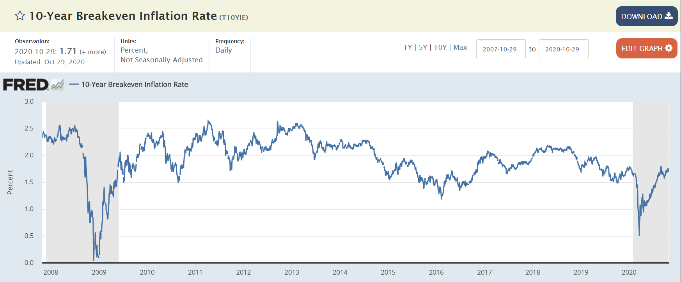
Breakeven Inflation : Market Expectations

