Slide 1
Central Banks

Slide 2
Brain Teaser
If I flip a fair coin 5 times in a row what’s the probability of getting at least 3 heads in a row?

Slide 3
Solution: Brain Teaser
25% chance
2^5 = 32 possible combinations
1 case of 5 heads in a row
2 cases of 4 heads in a row
5 cases of 3 heads in a row

Slide 4
Central Banks Basics
Core Functions
Government Bank
Monopoly issuer of currency, reserves
Conventional policy tool: interest rate
Goal: Control money and credit
Bankers Bank
Bank reserve accounts
LoLR
Manage payments system
Ultimate goal: Stability as a public good

Slide 5
What is stability?
Modern objective of central banks
Low and stable inflation
High and stable economic growth
Stable financial markets and institutions
Stable currency and interest rates
Not all central banks adopt these objectives

Slide 6
Effectiveness
What a central bank needs to be effective
Independent
Instrument independence vs goal dependence
Transparency
Explicit goals and framework
Committee decisions

Slide 7
Monetary Policy Strategy
The Fed’s Policies
Controlling expectations is key- relates to investor and consumer behavior
Rule like behavior reduces uncertainty- constrained discretion
Stable inflation expectations are key to real interest rates
Real rates = nominal – inflation expectations
Try to avoid time consistency

Slide 8
Monetary Policy vs Fiscal Policy
The Fed vs the Government
Government funding needs can clash with monetary policy
Fiscal dominance and monetary policy
Runaway inflation/default

Slide 9
Central Banks Balance Sheet
Assets | Liabilities
FX reserves | Currency
Securities | Government deposits
Loans | Commercial bank deposits
How it works: when central bank purchases a 1MM bond, it adds 1MM to the owners bank account by adding it to the reserve account of the commercial bank.

Slide 10
Central Bank Balance Sheet
OMO
FX Intervention
Discount Loans
Individual withdraws cash from a bank

Slide 11
Multiple Deposit Creation
Printing Money
Central bank controls supply of monetary base: deposits + currency
Deposit expansion multiplier: increase in commercial bank deposits after 1 dollar OMO market purchase (when banks receive deposits, they loan it out)
Money multiplier: from quantity of money and monetary base
Central banks do not make money they change the monetary base
Function of excess reserves, required reserves, deposits)

Slide 12
What is the FOMC
Made up of voting governors
7 governors + NY Fed President + 4 other district bank presidents
Chair = most influential
Duties: Set interest rates to control money and credit, determine scale and mix of assets
Use FFR and IOER
Issue statements about policy

Slide 13
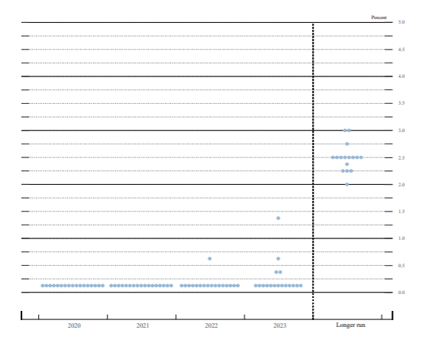
Fed’s Dot Plot

Slide 14
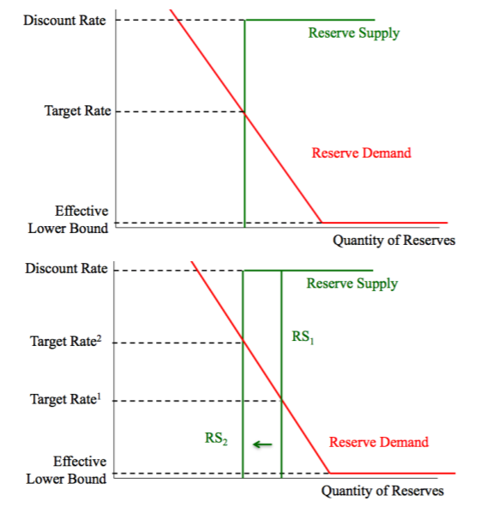
How the Fed used to set Policy
Target Federal Funds Rate
Discount rate = ceiling
Use OMO to determine supply

Slide 15
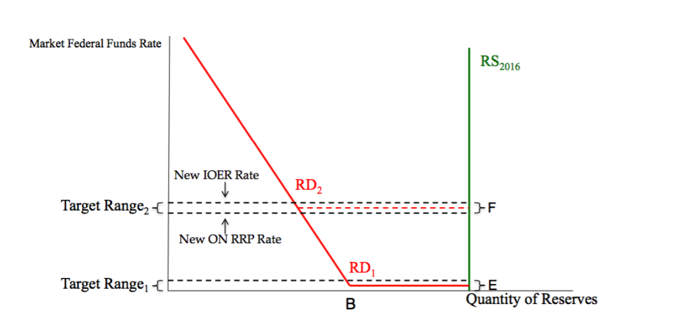
How the Fed sets policy today
Most reserves today = excess
Cannot use OMO
IOER = rate paid by Fed on reserves that banks hold in excess of reserve requirement
Use ON Reverse Repo Rate – rate paid by Fed on funds from non-banks supplied via overnight reverse repo

Slide 16
When the Fed Pulls Out All the Stops
Money Printer Go Brrr….
Rate Cuts & Forward Guidance
Quantitative Easing
Primary / Secondary Market Corporate Credit Facility
Average Inflation Targeting (AIT) Strategy
What’s Next?
Yield Curve Control
“Helicopter Money”
Negative Interest Rates
Dual Interest Rates / TLTROs

Slide 17
Central Bank Asset Purchases
Types of assets that may be purchased:
Government bonds – Almost always
Mortgage-backed securities / covered bonds
Investment-Grade Corporate Bonds
Real Estate Investment Trusts (REITs)
Equities / Exchange-Traded Funds (ETFs)
Why do different central banks buy different assets?
Different markets have different needs
Equities – Swiss National Bank, Bank of Japan
Corporate bonds – Bank of England, European Central Bank
Mortgage-backed securities – Federal Reserve

Slide 18
Yield Curve Control – Why?
Yield Curve Control vs. Quantitative Easing:
Yield Curve Control: Targets price (i.e. yield)
Quantitative Easing: Targets quantity
Why opt for yield curve control?
Banks and pension funds
Fiscal stimulus & helicopter money
Which yield curve?
Bank of Japan (2016): 10-year JGB yield
Reserve Bank of Australia (2020): 3-year AGB yield
Federal Reserve (???): What do you think?

Slide 19
Helicopter Money
Bernanke (2003): Some Thoughts on Monetary Policy in Japan
“Consider…a tax cut…that is explicitly coupled with…purchases of govt debt – so that the tax cut is financed by money creation”
“Purchases would leave the nominal quantity of debt in the hands of the public unchanged, while nominal GDP would rise due to household spending”
Monetary Finance - Why?
No Ricardian Equivalence (vs. Deficit Spending)
Certain to stimulate demand (vs. Monetary Stimulus)
No unsustainable credit booms (vs. Negative Interest Rates)
Milton Friedman on Helicopter Money:
“In periods of unemployment, it is less deflationary to issue securities than to levy taxes. That is true. But it is still less deflationary to issue money.”

Slide 20
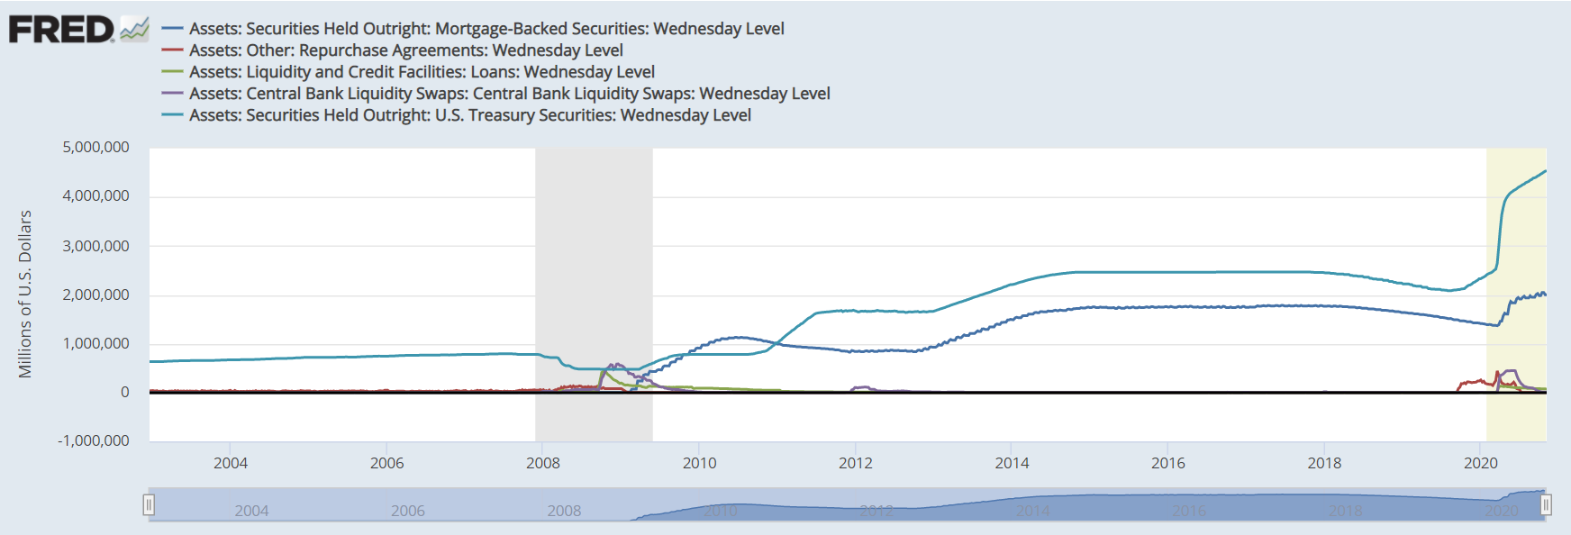
The Fed’s Balance Sheet

Slide 21
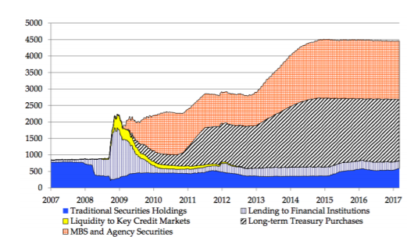
The Fed’s Balance Sheet

Slide 22
Get in Touch
Feel free to reach out to us over Facebook or email if you have any questions
www.quantfsnyu.com
quantfsnyu@gmail.com
President – Avni Patel (avni.patel@stern.nyu.edu)
Co – Head of All Portfolios – Cory Peshkin (cory.peshkin@stern.nyu.edu)
Co – Head of All Portfolios – Peter Park (peter.park@stern.nyu.edu)

