Slide 1
Options 201 ☺

Slide 2
Brainteaser!
I'm driving out to a resort, which is pretty far away. Luckily, the first three quarters of the distance is all highway driving, but I have to drive the rest on slower local roads. I drive at 60 mph on the highway, but only 20 mph on local roads. What's my average speed for this trip?

Slide 3
Answer:
You might think you can just take a weighted average of the two speeds, and conclude the answer is just $\frac{3}{4}×60+ \frac{1}{4}×20=50$ mph, but that’s not correct! This is because average speed is calculated by averaging speed over time, not over distance.
Solution:
Let x be the total distance to the resort. The time you spend on the highway is $\frac{\frac{3}{4}x}{60}= \frac{x}{80}$ hours, and the time you spend on the local roads is $\frac{\frac{1}{4}x}{20}= \frac{x}{80}$ hours. Then your average speed is $\frac{x}{\frac{x}{80}+\frac{x}{80}}=40$ mph.

Slide 4
A quick review

Slide 5
Key Definitions
Call Option
An agreement that gives the buyer the right, but not the obligation, to buy an underlying asset at a specified price within a specific time period
Put Option
An agreement that gives the buyer the right, but not the obligation, to sell an underlying asset at a specified price within a specific time period

Slide 6
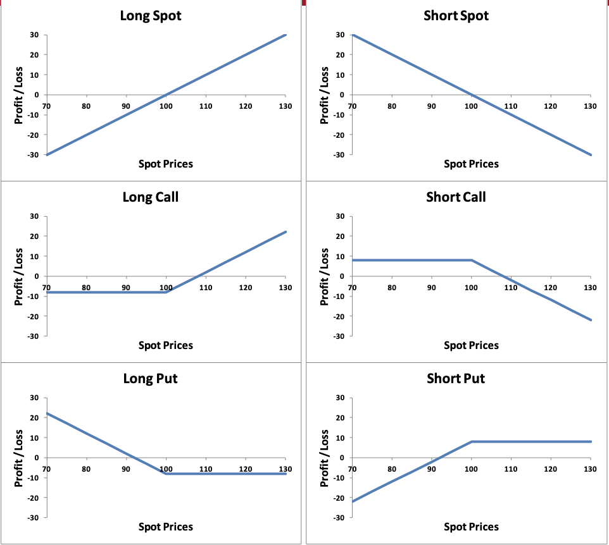
Summary Of Payoff Diagrams

Slide 7
Pricing

Slide 8
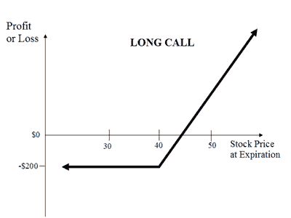
Pricing Exercise
How much do you think a call option should be priced if…
Strike price is 40
Price of underlying is 50
Expiration date is in a year

Slide 9
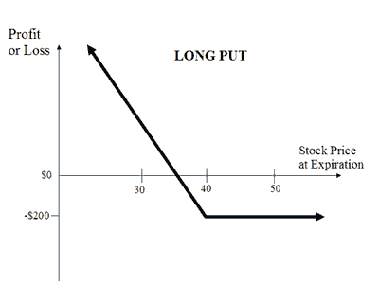
Pricing Exercise
How much do you think a put option should be priced if…
Strike price is 40
Price of underlying is 30
Expiration date is in a year

Slide 10
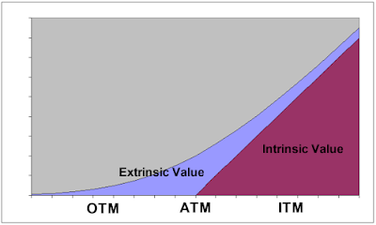
Extrinsic/intrinsic value
Value of an option: Black Scholes option pricing model is used to price options, but before we get there, let’s focus on extrinsic/ intrinsic pricing
Intrinsic- What is your profit from exercising the option? (difference between strike price and stock price)
Extrinsic- The rest of the options value (time and volatility)

Slide 11
Pricing Relationships
Max[0, S-K] <= C <= Stock
C(K_{L}) >= C(K_{H})
C(t₂) >= C(t₁)
Max[0, K-S] <= P <= K
PV(K_{L}) <= P(K_{H})
P(t₂) >= P(t₁)
Intrinsic vs. Extrinsic Value?

Slide 12
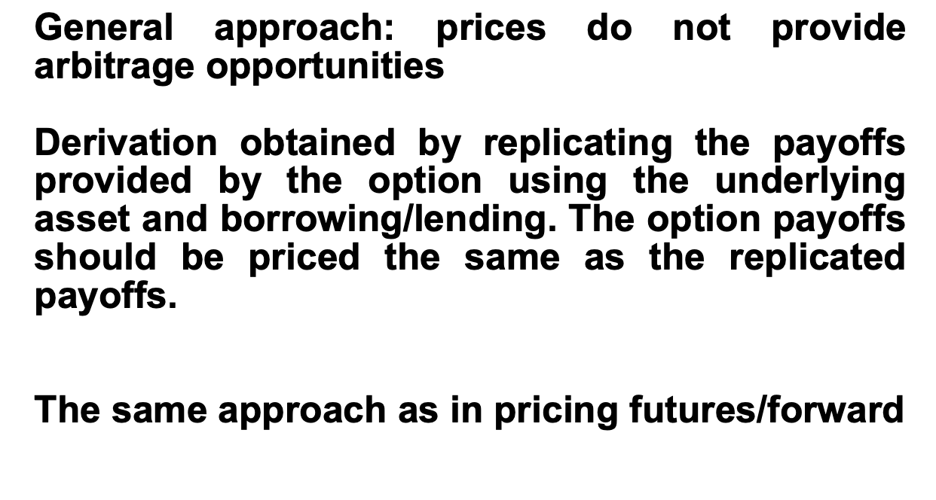
Put-Call Parity

Slide 13
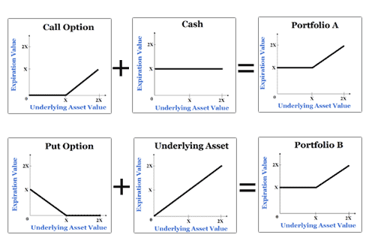
Put-Call Parity
Defines the relationship between the price of a European put and European call of the same class (same strike/underlying asset/expiration date)

Slide 14
Put-Call Parity
P + S = C + PV(K)
C = P + S – PV(K)

Slide 15
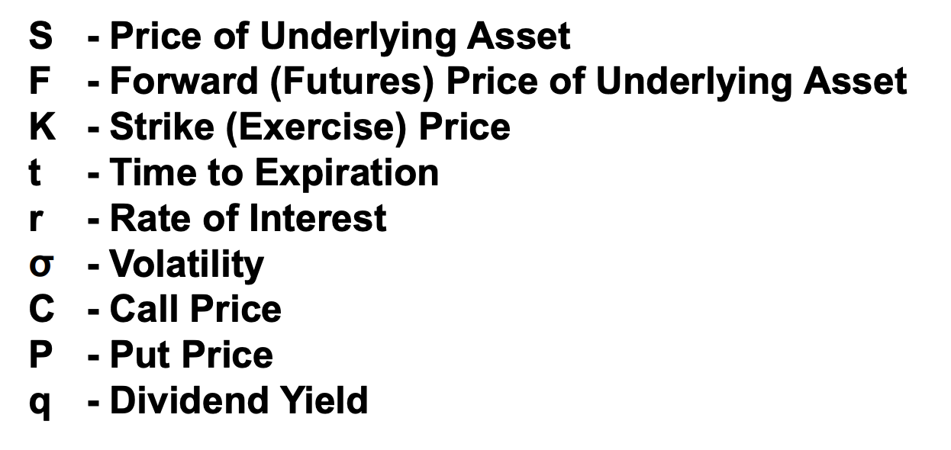
Black Scholes Inputs

Slide 16
Impact of Each Variable
What happens to the cost of a put option when the following variables change?
Price of underlying increases…
Strike price increases…
Volatility increases…
Time increases…
Interest rates increase…
Dividends increase…

Slide 17
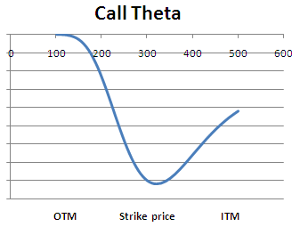
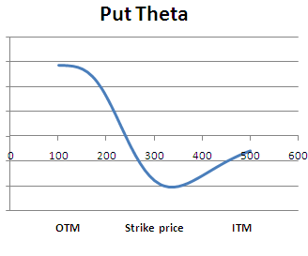
Theta
Change in value of option as you move closer to expiry (time decay)

Slide 18
Delta

Slide 19
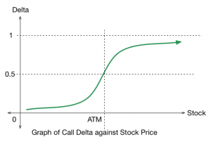
Delta
Change in price of option for every dollar movement in underlying

Slide 20
GAMMA

Slide 21
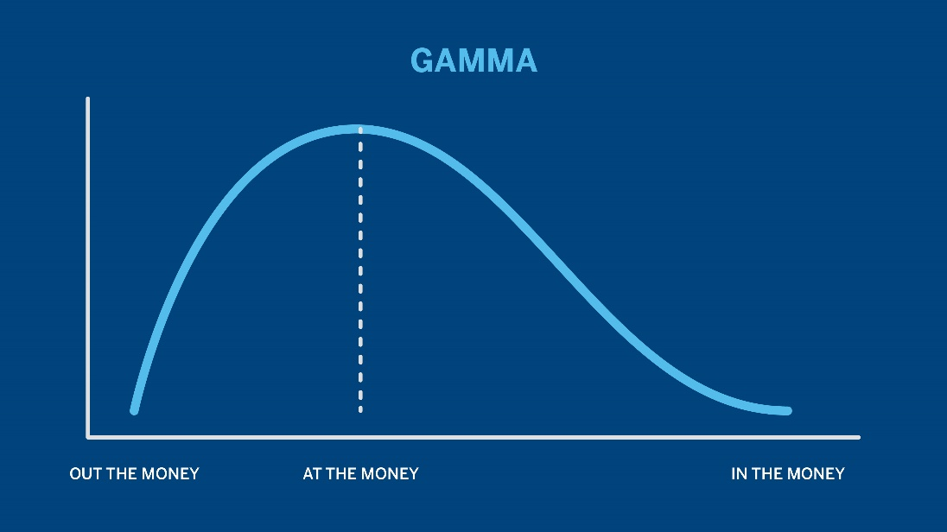
GAMMA
Second derivative of delta – measures rate of change in delta

Slide 22
vega

Slide 23
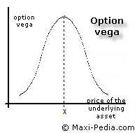
vega
Price sensitivity to 1% change in volatility of underlying

Slide 24
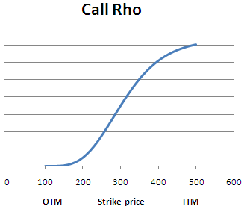
Rho
How sensitive options pricing is to interest rates

Slide 25
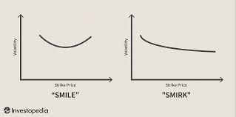
Volatility skew
Measures implied vol (demand) of options

