Slide 1
Quantitative Finance Society

Slide 2
Brain Teaser
In football, most scoring drives result in either field goals (3 points) or touchdowns (7 points including the extra point). Ignoring all the other ways to score in football (safeties, conversions, etc.), what is the largest score you cannot make with combinations of 3 and 7 points?
Learning
Investing
Community

Slide 3
Answer
11 points - Through trial and error, we see that 11 is unattainable but it is also the largest. This is because 12, 13, and 14 are all attainable
Any number above 14 can also be attained because it will be one of these plus an appropriate multiple of 3.
Learning
Investing
Community

Slide 4
Overview
QFS is a multi-strategy investment club that provides a platform for members to share knowledge and learn about the financial markets and investing
Our Focus
Learning
Investing
Community

Slide 5
Why Join QFS?
Learn
Practice
Explore
Learn different investing strategies across multiple assets (stocks, currencies, commodities, etc.)
Specifically dedicated to developing a strong grasp of financial knowledge
Gain hands-on experience and feedback in pitching and executing investment ideas
Get direct exposure to a wide variety of investing opportunities and career paths in the finance industry
Strong recruiting ties to a wide range of sell-side and buy-side financial jobs
Extensive alumni network across the financial industry, ranging from Investment Banking to hedge funds
Learning
Investing
Community

Slide 6
Alumni Network
IB/S&T
Buy-Side

Slide 7
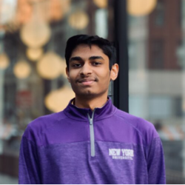
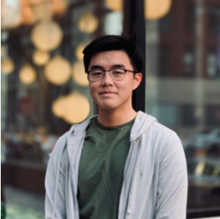
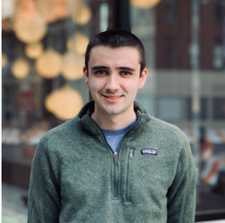
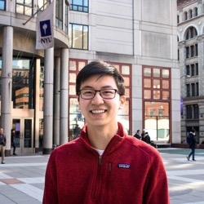
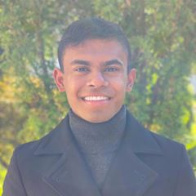
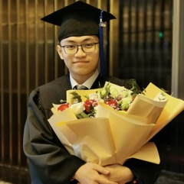
Our Executive Board
Ram Ramanathan
President
Alex Poon
Vice-President
Connor Sheehy
Co - Head of Portfolios
Kevin Duan
Co - Head of Portfolios
Jessica Wu
Treasurer
Ashwin Mathukumar
Co - Marketing Chair
Yukai Liu
Co - Marketing Chair
Peter Shi
Tech Chair

Slide 8
How to Get Involved?
General Meetings
Portfolio Team

Slide 9
1. General Meetings
Weekly workshops taught by portfolio team members of QFS on a variety of topics – open to all NYU students
Tuesday, 12:30 – 1:45 PM
Long Short
Learning
Investing
Community

Slide 10
Past General Meeting Topics
The Financial Industry
Intro to Asset Classes
Intro to Investing and Trading
Valuation Methodologies
Intro to Value Investing
Rates & FX
Intro to Credit Investing
Intro to Quant Investing
Intro to Options/Other Derivatives
P-Team Pitches

Slide 11
2. Portfolio Team
Join 1 of 3 teams (Long-Short, Macro, and Quant) and learn to develop investment ideas and manage our paper money portfolio
Weekly meetings
Portfolio Meeting – meet with your individual portfolio to discuss various investment ideas
All Portfolio Meeting – listen to pitches from the other portfolios and provide feedback
No prior investing experience or
financial knowledge required
Long Short
Learning
Investing
Community

Slide 12
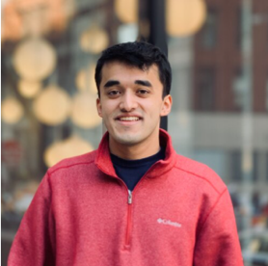
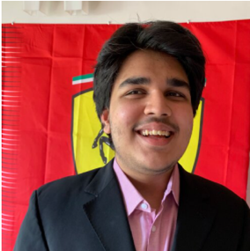
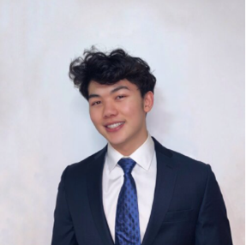
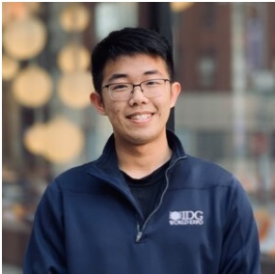
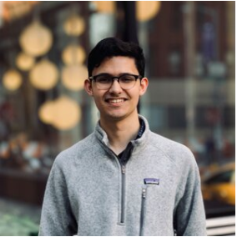
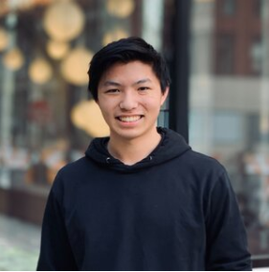
Our Portfolio Managers
Nikhil Naik
Long Short
Vish Choradia
Global Macro
Austin Tang
Quant
Weiting Hong
Long Short
Alexander Bizanek
Global Macro
Zachary Leng
Quant

Slide 13
Long-Short Portfolio
Overview
Sample Pitches
Applies fundamental and intensive bottom-up analysis to find undervalued stocks
Understands different business models and tries to find opportunities where price doesn’t equal value
Long Cumulus Media (NASDAQ: CMLS)
Long NMI Holdings (NASDAQ: NMIH)
Special Situations Book

Slide 14
Macro Portfolio
Overview
Sample Pitches
Follows global economic and political trends to develop cross-asset trades
Applies economics principles and analyzes current events to find mispricings in the market
Long Southeast Asian Corporate Debt
Long Brazilian Equities
Long Angolan Credit

Slide 15
Quant Portfolio
Overview
Sample Pitches
Builds quantitative models and strategies using given data to generate outsized returns
Backtest strategies based on historical data to understand historical performance
Hurricane Strategy
Chinese Pharmaceutical Pairs Trading
IGSB/IGLB Mean Reversion with Kalman Filtering

Slide 16
Q&A
Who is eligible to apply for Portfolio Team?
I am interested in learning more about finance, but I don’t have any prior experience in it - can I still be involved?
What is the difference between QFS, FS, and IAG?
Do you need to have a quantitative background to be part of QFS?
I am interested in exploring a career in investment banking / sales & trading / hedge funds, how can QFS help me?
I am not sure what all the above jobs even mean, how can QFS help me?

Slide 17
Application Process
1st round applications: Open 2/20 and close 2/26 at 11:55 PM
Virtual first round interviews: 2/28
2nd round interviews: Through the week of 3/6
Open House: Wednesday, 2/24 7:30 PM
Our applications test ability to think, general interest, and amount of effort
Join our mailing list to stay updated on events and due dates

Slide 18
Get in Touch
Feel free to reach out to us over Facebook or email if you have any questions
www.quantfsnyu.com
quantfsnyu@gmail.com
President – Ram Ramanathan (rer407@stern.nyu.edu)
Vice-President – Alex Poon (alex.poon@stern.nyu.edu)
Co – Head of All Portfolios – Connor Sheehy (connor.sheehy@stern.nyu.edu)
Co – Head of All Portfolios – Kevin Duan (skd359@stern.nyu.edu)

