Slide 1
General Meeting: Macro and Russia
February 12, 2019

Slide 2
Background
Population: 144.5mm
Currency: Ruble ($1 = 65.76₽)
GDP: 1.578 trillion USD, 10,743.10 USD per capita
Primary industries: Energy, Mining, griculture
6th largest economy (PPP) and 27th in economic complexity
What is the largest determinant of Russia’s exports?

Slide 3
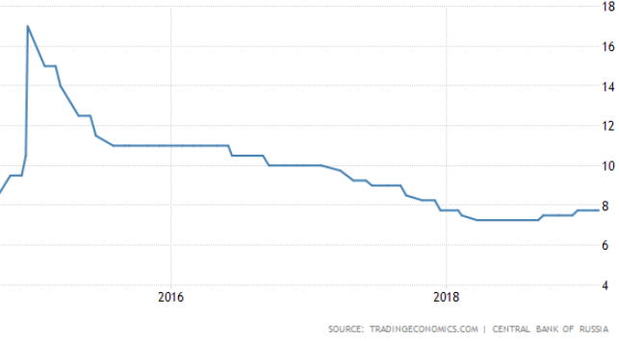
Central Bank
Interest Rate: 7.75%
Two 25bps hikes since September 2018
Half of profits must go to federal budget
Owns 58% of Sberbank
Complete ownership of Russian National Reinsurance Company
Governor Nabiullina: states that although not in a hiking cycle, there still may be more hikes this year

Slide 4
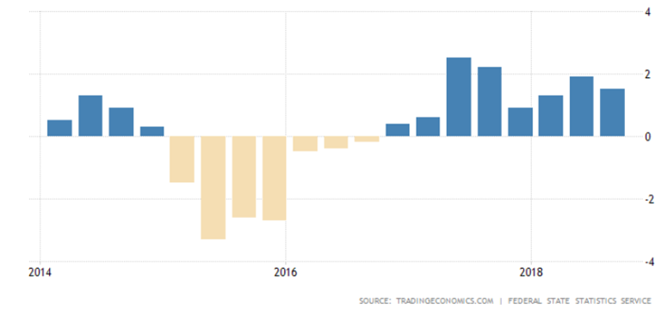
Russian GDP

Slide 5
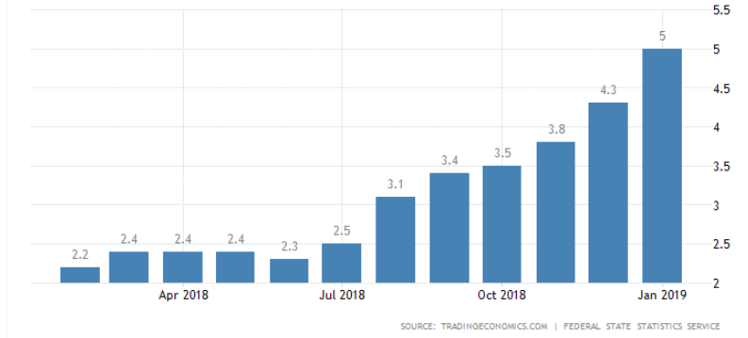
Inflation
CBRF target rate: 4% - Current: 5%
Recent spike: VAT increase from 18 to 20%, which is embedded in housing and utilities

Slide 6
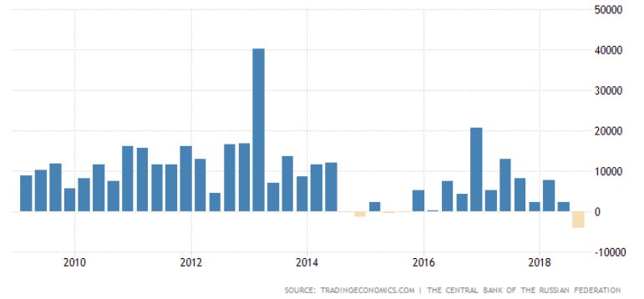
Foreign Direct Investment
Given the geo-political risks and an affinity for corruption, Russia has a difficult time generating foreign inflows of investment

Slide 7
Natural Resource Endowments
Largest Producer of:
Chromium – 30% of global output
Nickel – 19%
Palladium – 43%
Diamonds – 33%
Second largest producer of:
Aluminum – 10% of global output
Platinum – 12%
Zirconium – 19%
Oil (3rd), Gold (3rd), Silver (4th)

Slide 8
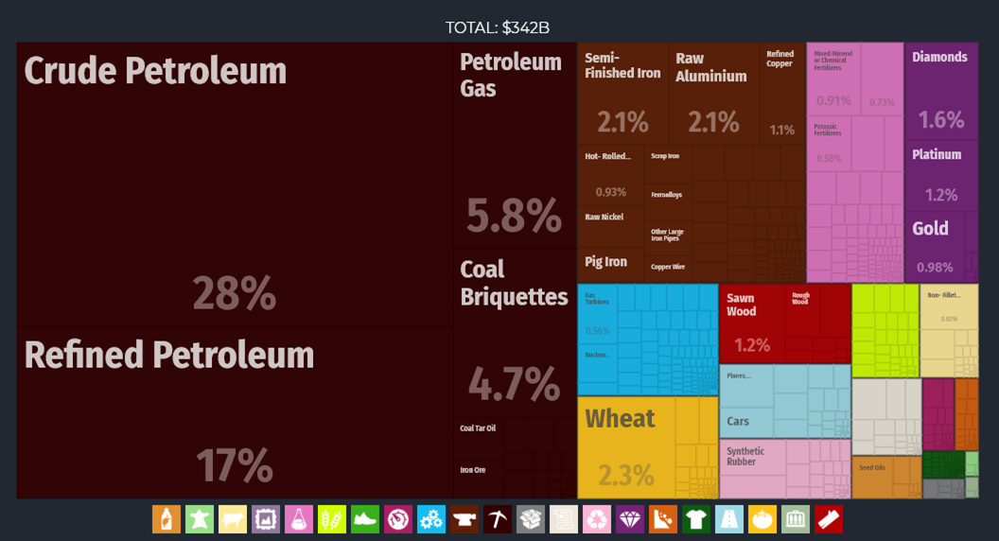
Exports

Slide 9
Why Sanction?
3 Theories of the effect of sanctions:
Orthodox
Rally around the Flag
Scapegoating
Frye, Timothy. “Economic Sanctions and Public Opinion: Survey Experiments from Russia.” Columbia University Department of Political Science, 9 Oct. 2017,

Slide 10
Sanctioning Russia
1. Crimean annexation
First Round of Sanctions
2. Downing of Malaysian Airlines flight MH17
3. Further military escalation in the Donbass region
4. Continual violations of the Minsk Protocol Ceasefire Agreement

Slide 11
Smart-Sanctions
Asset freezes and visa bans on over 130 individuals and 28 entities
Suspension of European Bank for Reconstruction and Development preferential loans
A ban on trading securities in largest banks, energy and defense companies
A ban on loans to the largest five banks
A ban on exports of dual-use items (civilian goods that can be used in military)
A ban on specific shale, deep-water offshore, and Arctic oil exploration technologies

Slide 12
Were Sanctions Effective?
EU financial restrictions weakened credit conditions for Russia
Oct. 2014: Sovereign credit rated Baa2 (BBB)
March 2016: Ba1 (BB+)
Ruble and Russian equities collapse
Large public spending cuts and austerity to support [EU-loan] depleted banks
Large bailouts and amnesty on repatriated capital
65-79% of Russian rocket and space industry is now targeted (Silakova 2017)

Slide 13
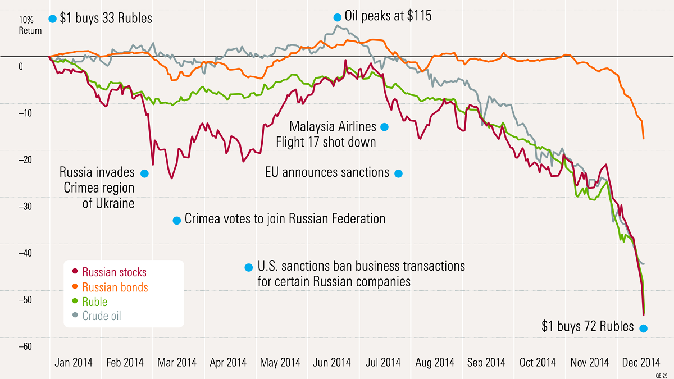
Text

Slide 14
Oil Collapse in tandem with Sanctions
2014 Saw oil prices fall dramatically for three reasons:
China, India, Brazil, and Russia had seen economic growth begin to slow
The US began producing via shale; Canada through oil sands
Saudi Arabia tactically continued to produce (in order to retain market share) rather than cut production
Saudi Arabia was able to weather this with the largest oil reserves in the world as well as incredibly low production costs
By keeping oil prices low there is less incentive for US and Canadian development of capital intensive exploration and development.

Slide 15
Post Sanctions?
Sanctions have been lifted against oligarch Oleg Deripaska after heavy lobbying
His business empire is built on the aluminum and power company EN+ Group, which owns United Company Rusal (9% of global aluminum)

Slide 16
Further Sanctions?
Sergei Skripal – furthered dual-use sanctions
US Senate “Bill from Hell”
Restrict relations with Russian oil firms
Restrict Russian sovereign debt transactions
Limit Uranium imports
Proposals warranted from election meddling
Other Macro Elements?

Slide 17
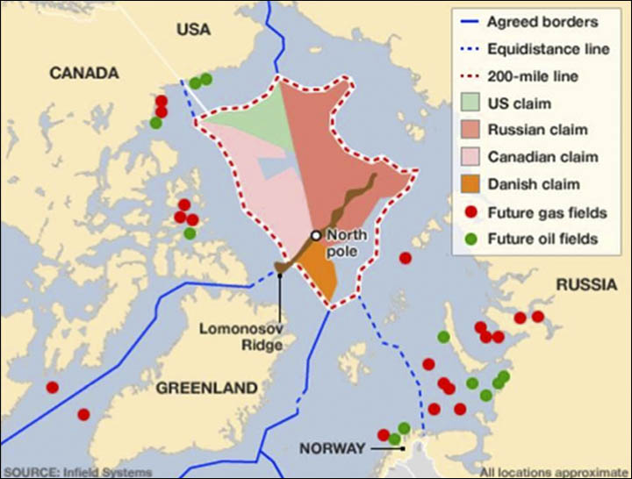
Macro Implications: Arctic Oil
Russia has halted exploration and development of untapped oil rigs due to sanctions
Access to these resource endowments will greatly influence commodity markets going forward

Slide 18
Macro Implications: Petro-yuan?
After the implementation of sanctions, Russia agreed to a $400 billion oil pipeline with China, which also includes the ability for oil to be transacted in either to ruble or yuan.
What is significant about this?
Will future sanctions further pivot Russia to Eastern markets or is this inevitable?

Slide 19
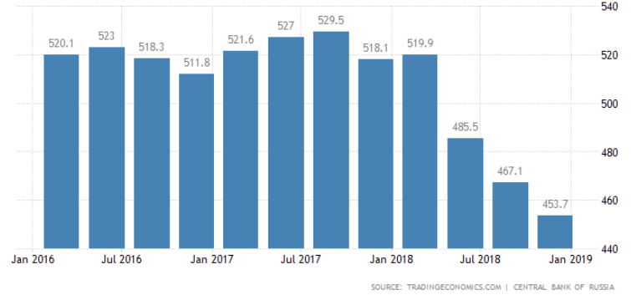
Russian Stabilization
2019-2021 Budget
$62 billion surplus
Healthcare and infrastructure reforms of 5.6tn rubles expected
Total External Debt:

Slide 20
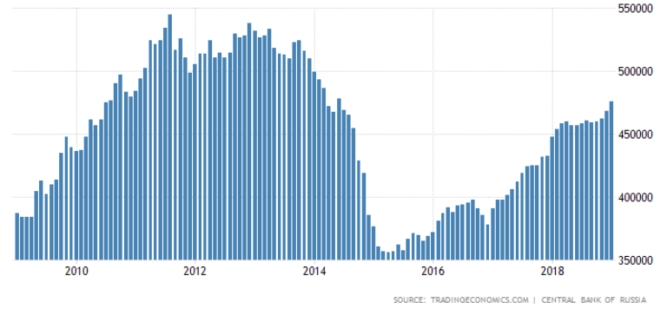
Russian Stabilization
Russia has bolstered foreign exchange reserves approaching pre-sanctions levels

Slide 21
Moody’s Re-rates Russia at Baa3
February 9th 2019: Moody’s rates sovereigns at Baa3 (BBB-)
What is significant about a Baa3 rating?
“The upgrade of Russia's ratings reflects the positive impact of policies enacted in recent years to strengthen Russia's already robust public finance and external metrics and reduce the country's vulnerability to external shocks including fresh sanctions. The stable outlook reflects evenly balanced upside and downside credit risks” – Moody’s

Slide 22
Trade Ideas?
Foreign Exchange
Credit
Sovereign Russian Bonds
Corporate Debt
Russian Equities
Rates
Commodities?

Slide 23
My Analysis
3 Theories of the effect of sanctions:
Orthodox
Rally around the Flag
Scapegoating
What is the ultimate goal of sanctions?
Frye, Timothy. “Economic Sanctions and Public, Opinion: Survey Experiments from Russia.” Columbia University Department of Political Science, 9 Oct. 2017

Slide 24
My Analysis
Russia has proven economic growth can be achieved despite broad international sanctions
Russian recovery efforts and proposed budget indicate emphasis on defensive stabilization, not economic growth or productivity
Russia’s incentives for regional hegemonic aggression are unchanged
Inflation will warrant 25 or 50bps higher interest rate

Slide 25
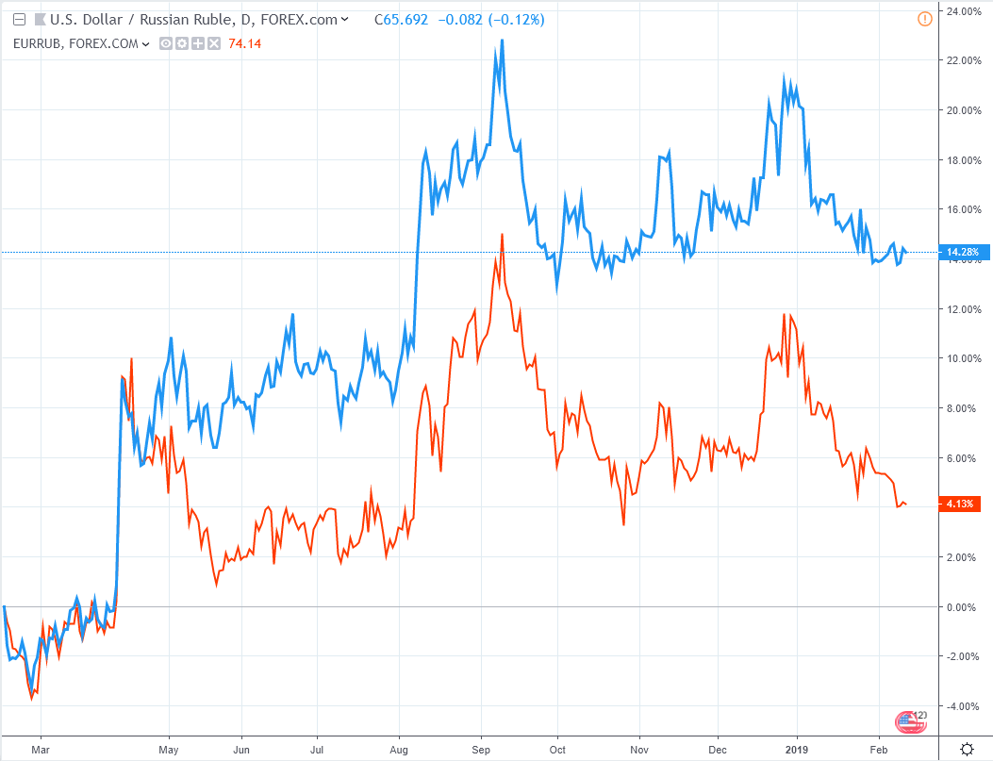
Short Ruble to USD or Euro
Text
US vs EU

Slide 26
Short Ruble to USD or Euro
Further geo-political risks will depreciate the Ruble
Instability and uncertainty will continue to reduce interest in foreign investment
Steady increases in foreign reserve purchases
Negative Carry >5%
Foreign Exchange is done through pairs:
Express long dollar or euro viewpoint

Slide 27
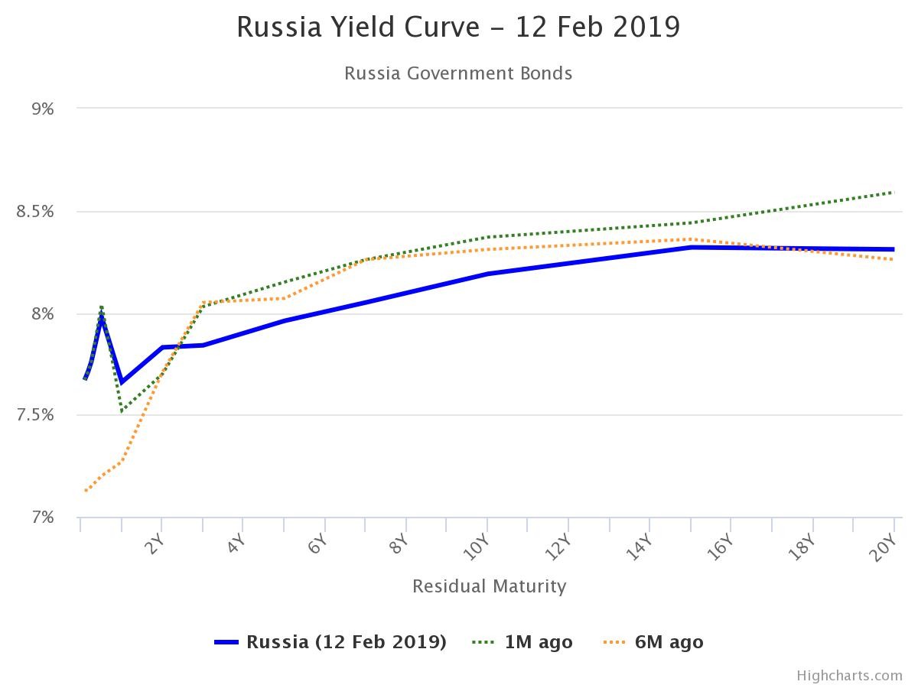
Enter a Yield Curve Flattener
A combo of buying short term bonds and shorting long term bonds
Higher inflation in the short term alongside
a hesitantly hawkish central bank in tandem with the prioritization of stability over growth (compounded by uncertainty of future aggressions)

Slide 28
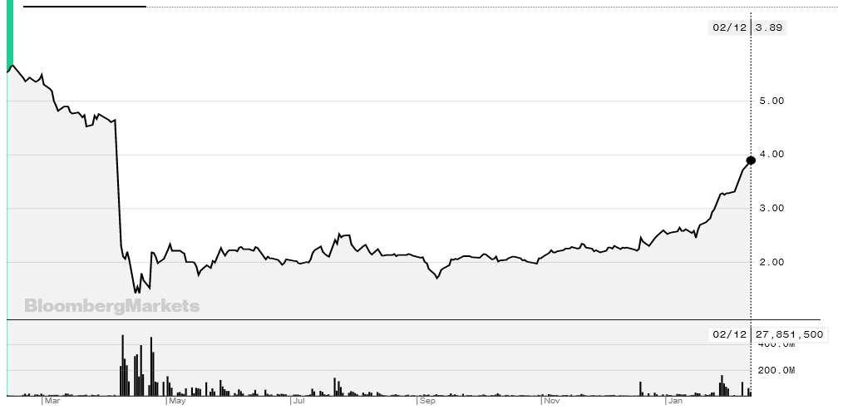
Short Rusal HK:486
Aluminum not yet resolved in China trade talks
Andrei Belousov: lobbied for taxes on mining and metals industries to further gov’t revenues
Sanctions Lifted

