Slide 1
Intro to Market Making and Quant Strategies

Slide 2
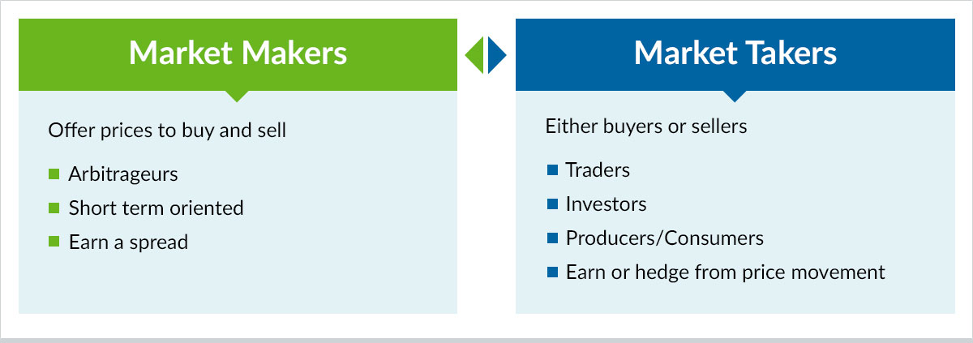
What is Market Making?
Providing liquidity by quoting two-sided markets, earning money off the spread between their quoted bid and offer.
Gives buyers and sellers a better deal, while still making money.

Slide 3
Brain Teaser
Question: What digit is the most frequent between the numbers 1 and 1,000 (inclusive)? What digit is the least frequent between the numbers 1 and 1,000 (inclusive)?

Slide 4
Solution: Brain Teaser
Solution:
The most common digit is 1 and the least
common digit is 0.
The digits 0 through 9 follow the same pattern. There is exactly 1 occurrence digit for every 10 numbers.
For instance, the digit 2 appears once between 10 and 19 and once between 30 and 39. 2 also appears in 20, 21, etc… and 200, 201, 202, etc… The only difference for 1 is that 1,000 includes a 1, so there is a single extra occurrence (301 vs. 300).
The reason 0 has the least occurrences is because 0 doesn’t have any equivalents to 22, 33, 44, 222, 333, etc…

Slide 5
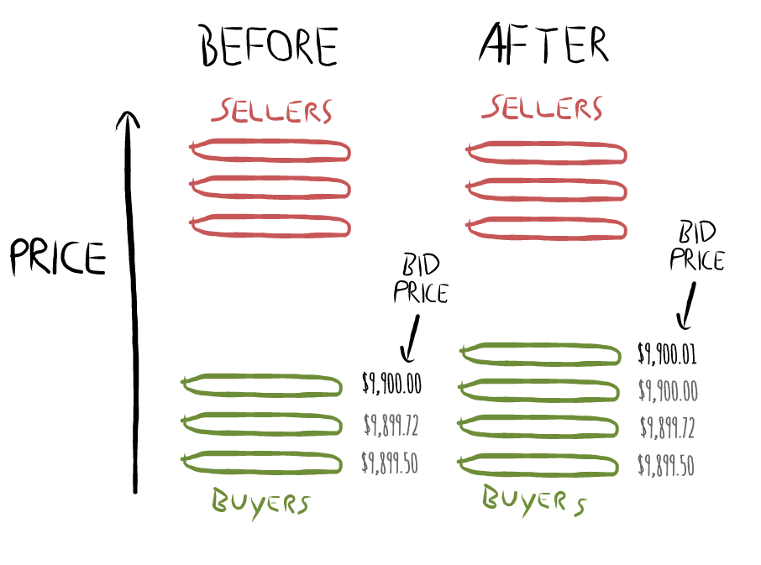
Profiting
Returns
Can “buy low, sell high” by quoting a bid price and a higher ask
High volume & small spread generally most profitable
Vs ECNs fixed commission
Risks
MMs are compensated for short-term risk of price fluctuations of an asset after it’s been bought but before it’s been sold
Risk of directional exposure on bad quotes

Slide 6
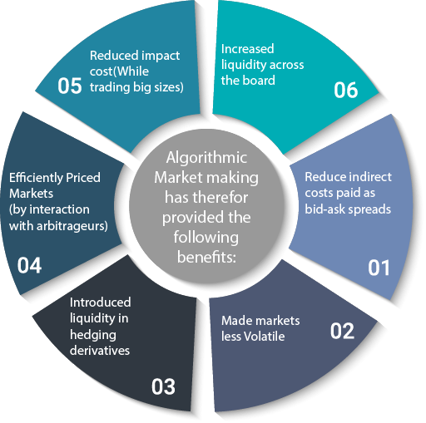
Exchange Benefits
If an MM becomes a designated market maker,
Exchange will require two-sided markets and a certain amount of volume
MMs can get monopoly or few competitors on an asset
Previously, could naked short and knew identity of orders
Why trade w/ MMs?
Immediacy -
Hedge fund believes stock undervalued and wants to buy now
Retail investor wants to buy before stock moons
Etc.

Slide 7
Market Making Strategies
Edge: determine a fair market price, and then place a bid and ask of equal volume at fair price +/- some edge value (e.g. $0.10)
Fade
Say that while you are quoting, someone lifts your entire offer and wants more
It is possible this counterparty knows more than us
Penalize large, unbalanced trades by adjusting fair price with position
Slack
Now assume an uninformed party buys up all your offers and wants more
If we don’t have more orders on the market, we miss out on exploiting this chump
We can add extra orders at higher edges, most of the time won’t be traded against
Pennying
Beat other MMs’ quotes by a single tick to take volume, usually in illiquid markets
Would rather make slightly less on many more trades

Slide 8
The Quant Process

Slide 9
Developing a Hypothesis
In general, look for ideas that are:
Fundamentally reasonable
To be sure we’re not making something from nothing, we start our strategies with some sort of market and stats viewpoint
Examples from this semester: SPAC units should trade near their split shares and warrants, cane sugar should correlate with refined sugar prices, country ETFs should have a positive relationship to their interest and currency rates
Novel
Look for markets or assets with lots of noise, creating opportunity for systematic strategies
If the idea is obvious, another prop shop has done it better than you

Slide 10
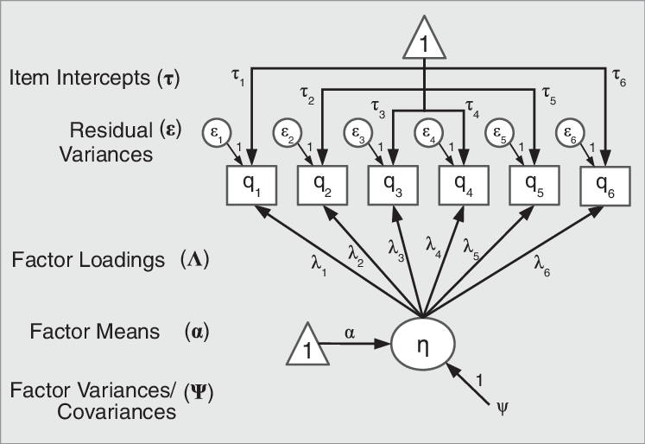
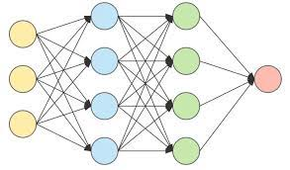
Modelling
Two “Methods”:
Explicit Modelling
Factor models / component analysis
Calculating spreads
Trading mean-reversion and momentum
Signal Processing
Stochastics – timeseries analysis
Optimal filtering
Assorted machine learning bullshit

Slide 11
Backtesting
Data Collection
Create datasets of historical prices, inputs of whatever else is needed (google trends data, oil prices, weather, etc.)
Query from Bloomberg or scrape from the internet
Cleaning
Fill in missing fields – can use previous days’ information, but can’t interpolate – why?
Price: open/high/adj. close
(Why might I avoid high?)
Adjust for dividends and stock splits
Train/Test
Split dataset into a training set and a testing set
Optimize parameters (coefficients, z-score, spread signal, holding days, etc.) and then evaluate the optimized algorithm on the test set

Slide 12
Evaluation
Stability – does this work with slightly different parameters?
Returns
The most basic metric, lets us determine the EV of this strategy
(If returns are sufficiently negative, shorting the strategy might be useful!)
Volatility
We prefer lesser price fluctuations
Can be combined with mean returns and risk-free for the Sharpe ratio, other ratios exist but suck
A low-return, low vol strategy can be levered up, can possibly beat a high-return, high vol strategy
Nature of trades
Favor fewer trades to avoid paying trade fees (when applicable) and bid-ask
10,000 trades with 51% accuracy or 1000 with 95%?

Slide 13
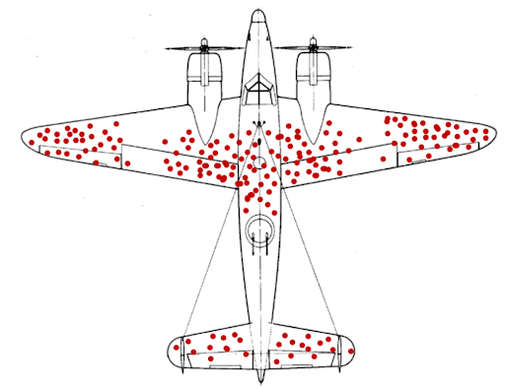
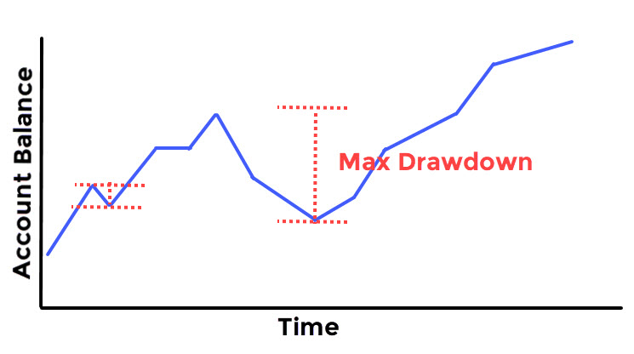
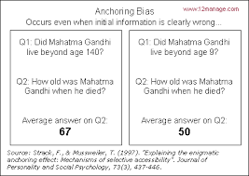
Understanding Bias
Optimization Bias (curve-fitting / data-snooping)
Particularly nasty
Continuously adjusting the model until we reach satisfying results
An algo can just be outright bad
Survivorship Bias
You’ve seen it before
Must pick companies that have survived the whole historical period, which may not be true for companies picked in the future
Psychological pain
150% overall returns look nice until you are in the trough
A trader may not stomach long/large drawdowns that look less severe in hindsight
Look-Ahead Bias
Future data can be accidentally introduced during training
Can lead to overfitting
Will not work for the model in real-time
Anchoring
Prioritizing earlier information
More of an issue for humans than algorithms, but can influence model structure

