Slide 1
Gamestonk.

Slide 2
Brain Teaser
Five pirates happen upon a treasure of a 100 gold coins
They must now decide how to divvy up the coins. The system they follow is that the oldest member proposes a solution, if his solution is approved by 50% or more of the pirates, they will use that solution. If it is not approved, he will be thrown overboard.
Pirates make their decisions according to what will get them the most money without getting killed. Pirates would rather kill than not, so if all things are equal, the pirate will be thrown overboard. There are no inter-pirate agreements.

Slide 3
Solution: Brain Teaser
Solution:
Oldest Pirate: A, 2nd-youngest Pirate: B etc.
A:98, B:0, C:1. D:0, E:1
Working backwards from two pirates (D and E), D would pick D:100, E:0, since he has the 50% to approve on his own. So then going one backward, C would offer E 1 coin because that’s more than he would get otherwise (C:99, D:0, E:1). Working backward again, B would offer D 1 coin since he is now getting more than he would otherwise (B:99, C:0, D:1, E:0). Working backward a last time now, we see that A can offer C and E, 1 coin because that’s more than they would get otherwise, so the end result is A:98, B:0, C:1, D:0 E:1

Slide 4
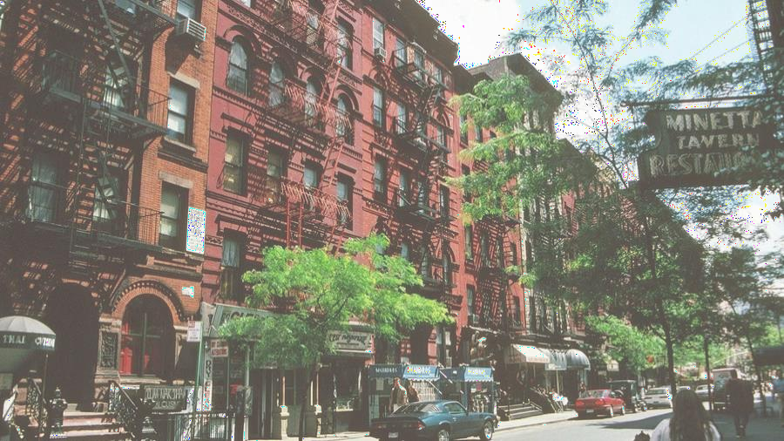
Por t folio Team Application
Timeline:
Opens on 2/20
Closes on 2/26 at 11:55PM
Eligibility: open to all NYU students
Application Process:
Fill in Google form (admin details & portfolio preference)
Combine your resume and application response into a single PDF and submit it
All instructions will be on the front page of our website, and emailed to everyone on our mailing list

Slide 5
Open House
Time:
2/24 at 7:30 PM
Zoom link: https://nyu.zoom.us/j/95107873682
Investment Pitches:
Each portfolio team will present a pitch to give you more insights on what our portfolios focus on & their investment strategies
You are encouraged to participate during the pitches and ask any questions you may have
You will also get a chance to talk to members of the portfolio team and learn more about what they do

Slide 6
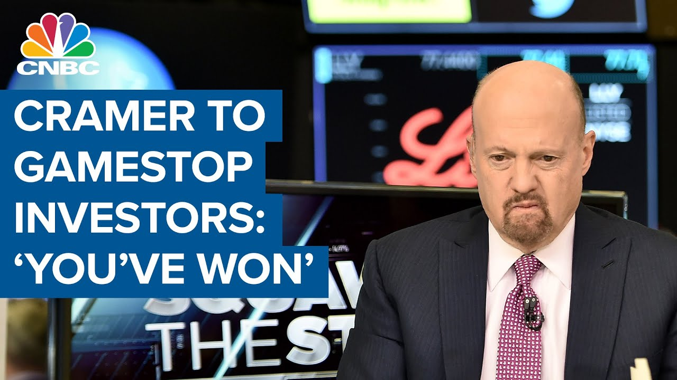
What Happened?
“Once-in-a-decade” price surge
“Victory” against hedge funds
Bad memes & broken dreams

Slide 7
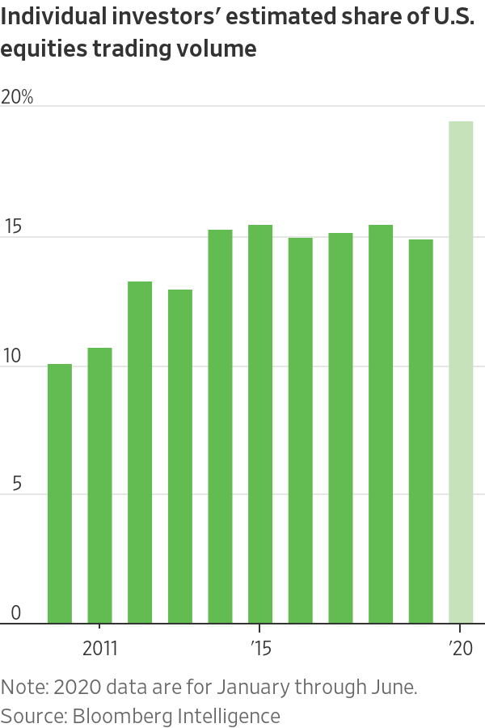
Year of the Retail Investor
Record new accounts
Webull, Robinhood
commission-free, online trading
r/WSB subscribers up 6x
Record new investors
Tiktok (stocktok)
Twitter
Reddit

Slide 8
Beginning of the End
Why was Gamestop shorted in the first place?
“Blockbuster of Video Games”
$10bn revenue in 2011, $6bn in 2019
Increase in PC gaming and next-gen digital sales
Peak 140% short interest (How do you break 100%?
Notable Positions
Long: Ryan Cohen, Chamath Palihapitiya, Michael Burry
Short: Melvin Capital (Citadel, Point72), Citron Research (Andrew Left)

Slide 9
Some Definitions
Short
A bet that the stock price goes down
Borrow a stock now and sell it for market price, repurchase later to return to the lender and keep the difference
Infinite downside
Call Option
A bet that the stock price goes up
Pay a premium for the option to buy the stock at a later date for a predetermined price
Limited downside
Used as a short hedge
Market Maker
Institutions who provide liquidity in the market
Quotes buy and sell prices, hoping to pocket the bid/ask spread
They write options!

Slide 10
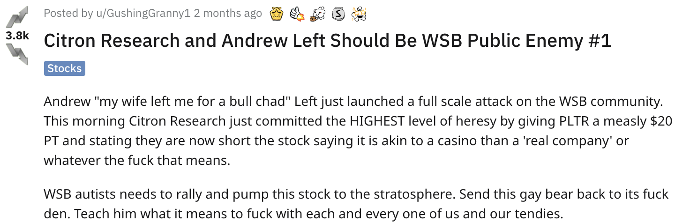
The Short...
Ryan Cohen (Chewy CEO), Consoles/Pandemic Gaming, & Memes

Slide 11
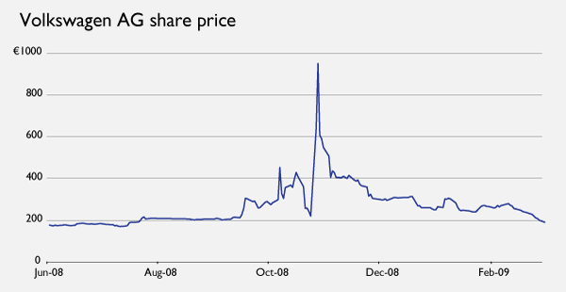
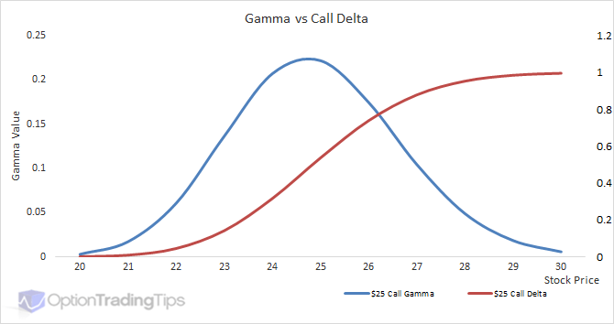
...and the Squeeze(s)
Short squeeze
When the price goes up, skittish shorts cover their losing position
The higher the price, the greater the pressure to buyback
Buying the share drives price up
ad infinitum
Gamma squeeze
Market makers offer calls, and must be prepared to deliver underlying
At time of writing, buy some amount of stock based on option delta
As price increases, gamma drives delta up, & MMs must buy to cover ITM options
Higher strike options are written and purchased by speculators and shorts, which must also be hedged

Slide 12
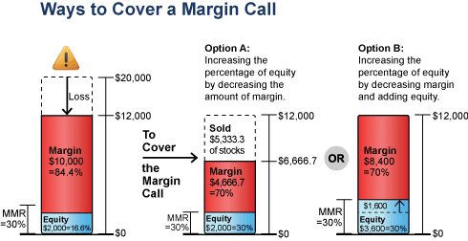
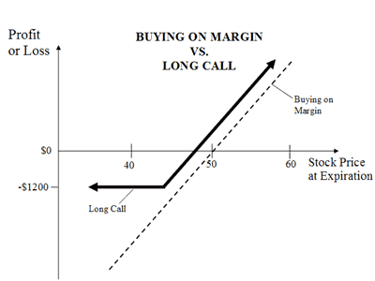
Squeeze(s) pt. 2
Buying on Margin
Borrowing money from a lender to purchase stock
Magnifies risk - greater returns, greater losses
Margin accounts do not “control” their shares, they are collateral
Margin Calls
Borrowers must maintain a minimum level of equity in a margin account
If the value of equity decreases below a percentage of margin, banks will issue a margin call
If additional funds are not deposited, banks will sell an account’s stocks to cover the margin

Slide 13
The Aftermath
V O L A T I L I T Y !
Restricted Trading
DTCC settles most securities transactions, volume in the quadrillions
DTCC & other clearinghouses impose a cost of collateral for the holding period, and volatility made GME clearing costs prohibitively expensive
Put Vega
Deep OTM puts purchased before the spike were up more than 300%. Had almost no intrinsic value.
Vega > Delta

Slide 14
cont’d
Margin calls
Reddit bot accounts
WSB posts supporting silver
Banks positioning alongside fake reddit posts
SEC investigation
Robinhood investigated for restrictions
Reddit investigated for manipulation

Slide 15
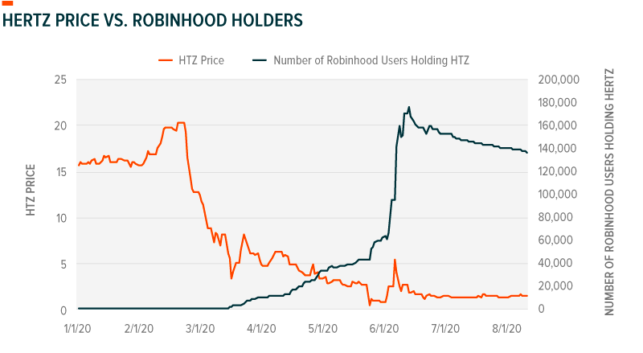
Risks for Individual Investors
Individuals lose much easier than institutions
Trends continue on AMC, Dogecoin, etc.
Retail tends to be the last ones in line
VWAP of GME
30-day average price of transaction for GME was $110
At $52, implies average purchase of a share lost $60

