Slide 1
Intro to Derivatives: Options

Slide 2
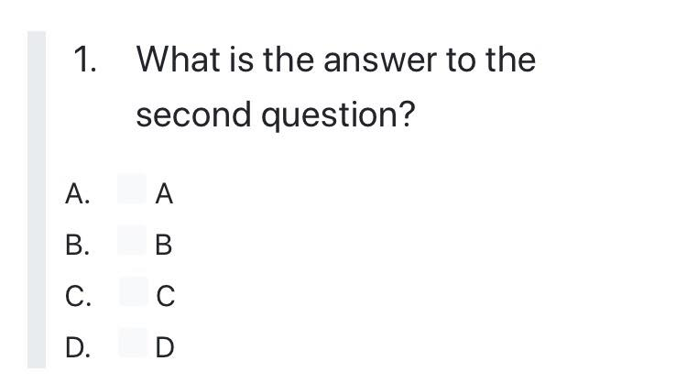
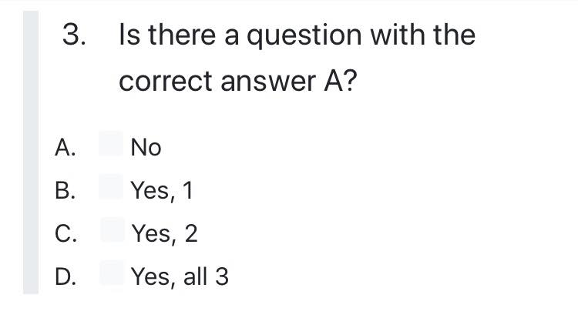
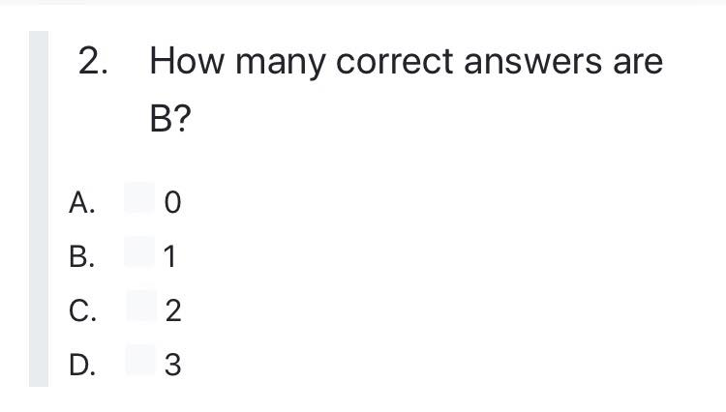
Brainteaser!
What are the answers to these MC questions?
Hint: Start with Question 3

Slide 3
Answer:
Examine Question 3. Suppose no questions have an answer of A. Then the answer to question 3 would be A, a contradiction since we supposed none of the answers were A. Thus, there must be at least one A, and Question 3 is not A so either Question 1 or Question 2 is A. Since Question 1 always has the same answer as Question 2, if one of the two is A then both must be A. So both Question 1 and Question 2 are A, which means there are 2 answers that are A. Thus, the answer to Question 3 is C, so the final set of answers is AAC. Going back to check our work, we can verify that AAC makes all three questions true.

Slide 4
What Is a Derivative?
Derivative
A derivative is a financial instrument, whose value is from the value of another underlying asset
When the price of the underlying changes, the value of the derivative also changes
Types of Derivatives
Forwards/Futures
Options
Swaps
Warrants/Convertibles

Slide 5
What was the first financial derivative?
British – Opium Derivatives, 1850
Dutch – Tulip Derivatives, 1636
Japan – Dojima Rice Exchange, 1697
India – Cotton Derivatives, 1875
Chicago – Chicago Board of Trade Grain Futures, 1864

Slide 6
Futures and Forwards
Futures and Forwards
Allow you to lock in a price at some point in the future.
Physical or cash settled
Often used by corporations for hedging
Main asset classes: Equity indices, VIX, commodities, FX, rates
Pricing
$$Futures Price≈E\left[Spot @ T\right]≈Forward Price$$
Negotiate price to pay at t=T
Exchange underlying at agreed prior price*
t=0
t=t
t=T

Slide 7
Pricing Futures
$$Futures Price≈disc.(E_{t}\left[{Spot}_{T}\right])≈Forward Price$$
1. Arbitrage Pricing
$Futures Price \left(t,T\right)=Spot\left(t\right)∗e^{(r+s−c)(T−t)}$
2. Expectation Pricing
$$Futures Price=E_{t}\left\{Spot\left(T\right)\right\}∗e^{−(r)(T−t)}$$

Slide 8
Futures and Forwards Compared
Futures | Forwards
Exchange Traded | Over the Counter
Standardized | Bespoke
No counterparty risk | Credit default risk of counterparty
Actively Traded | Non-transferrable
Marked to Market | Open and Close
Margined | Unmargined

Slide 9
Counterparty Risk
Counterparty Risk
The risk that one of the parties within a transaction may default or renege on a prior obligation
Is this generally a problem?
No
Buyer
Forward
Seller
Buyer
Future
Clearinghouse
Seller

